Slide 1
Analysis of acoustic-to-articulatory speech inversion across different accents and languages
Ganesh Sivaraman¹, Carol Espy-Wilson¹, Martijn Wieling²
¹University of Maryland College Park, MD, USA ²Faculty of Computational Linguistics, Rijksuniversiteit Groningen, Netherlands

Slide 2
Overview
Acoustic to articulatory speech inversion
Articulatory dataset
Contents of the dataset
Converting EMA sensor data to Tract Variables
Speech inversion system
Leave one speaker out experiments
Results of leave one speaker out tests
Cross accent and cross language experiments
Results of cross experiments
Example plot of a Dutch utterance
Example plot of an English utterance
Conclusion

Slide 3
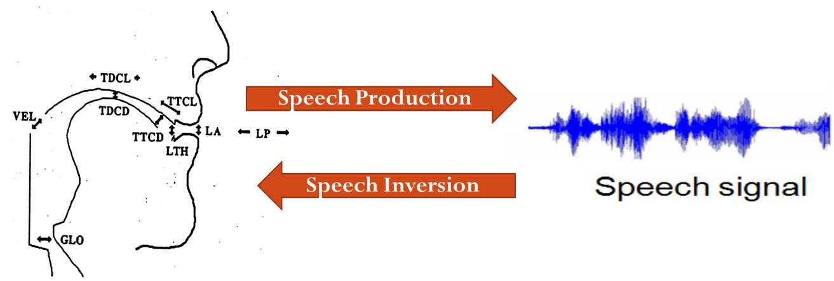
Acoustic to Articulatory Speech Inversion
Challenges
Highly nonlinear and somewhat non-unique mapping from acoustics to articulations (C. Qin, and Carreira-Perpiñán, 2007)
Multiple possible representations of articulatory data
Approaches
Codebook based approaches (Schroeter and Sondhi, (1994))
Gaussian Mixture Models (GMM) and Hidden Markov Models (HMMs) (Toda et al., (2004))
Artificial Neural Networks (ANN) (V. Mitra, 2010)
Notes:
Get rid of this. Include the info in 11

Slide 4
Articulatory Dataset
Electromagnetic Articulometry (EMA) data collected from 21 native Dutch speakers and 22 UK English speakers to compare the pronunciation and articulation of English by Dutch speakers to the English pronunciation of native Southern Standard British English speakers (M. Wieling et.al. 2015)
Missing data due to sensor errors and falloffs were estimated using conditional probability distributions of sensor positions derived from correctly measured data. (C. Qin, and Carreira-Perpiñán, 2010)
NL dataset | 21 Dutch speakers producing the Dutch version of the North Wind passage, followed by the collection of about 125 words and non-words. | 185 minutes
UK dataset | 22 UK English speakers producing the North wind passage, 175 English words and non-words, & some TIMIT sentences | 235 minutes

Slide 5
Contents of the datasets
NL dataset
UK dataset
Noordenwind passage (Dutch):
De noordenwind en de zon waren erover aan het redetwisten...
Dutch words & non-words
Mit, siet, faais, siez, hot, feef...
North wind passage (English)
Please call Stella passage (English)
English words & non-words
Sheet, serve, links, tenth, seam, kit,…
North wind passage (English):
The North Wind and the Sun were disputing which was the stronger,…
Please call Stella passage (English)
English words & non-words
Bathe, steal, genes, through, but,…
Few TIMIT sentence (time permitting)
Grandmother outgrew her upbringing in petticoats.
At twilight on the twelfth day we'll have Chablis.
Catastrophic economic cutbacks neglect the poor.

Slide 6
Converting EMA sensor data to Tract Variables
Tract Variable | Description
LA | Lip Aperture
LP | Lip Protrusion
LW | Lip Width
JA | Jaw Angle
TTCL | Tongue Tip Constriction Location
TTCD | Tongue Tip Constriction Degree
TMCL | Tongue Middle Constriction Location
TMCD | Tongue Middle Constriction Degree
TBCL | Tongue Back Constriction Location
TBCD | Tongue Back Constriction Degree

Slide 7
Speech inversion system
Input Speech
MFCC Feature extraction
Contextual window of 350ms
Kalman Smoothing
Tract Variables
Function mapping approach to speech inversion
Artificial neural networks (ANN) suitable for the highly non-linear and non-unique mapping from acoustics to TVs (V.Mitra, 2010)
Input features: Contextualized MFCCs (13 coeffs x 17 frames)
Outputs: 10 Tract Variables (TVs) (LA, LP, LW, JA, TTCL, TTCD, TMCL, TMCD, TBCL, TBCD)
TVs - functional description of vocal tract articulatory targets (Browman & Goldstein, 1989)
3 Hidden layer networks, 300 nodes in hidden layer
Adam optimizer used with 20% dropout while training

Slide 8
Leave one speaker out experiments
The NL and UK datasets were split into 4 different sets.
Speaker independent speech inversion systems were trained for every speaker by leaving that speaker out from the training set.
Performance evaluated using Pearson correlations and RMSE
Different speech inversion systems were trained to estimate sensor positions and TVs
Subset Name | Data | Amount of data
UK English | English utterances from 22 UK English speakers | 235 mins
NL Dutch | Dutch utterances from 21 L1 Dutch subjects | 60 mins
NL English | English utterances from 21 L1 Dutch subjects | 126 mins
NL all | English and Dutch utterances from 21 L1 Dutch subjects | 186 mins

Slide 9
Results of leave one speaker out tests

Slide 10
Cross accent and cross language experiments
Each speech inversion system was tested on the test sets from other 3 subsets.
Example: UK English system was evaluated on NL English (cross accent), NL Dutch (cross language) and NL all subsets.
The systems from Leave one speaker out tests were used for testing. Testing of subsets from the NL datasets were performed in a speaker independent manner.
Performance evaluated using Pearson correlation and RMSE

Slide 11
Results of cross experiments
EMA sensor estimation
TV estimation
 | UK English | NL Dutch | NL English | NL all
UK English | 0.56 | 0.42 | 0.48 | 0.45
NL Dutch | 0.42 | 0.51 | 0.46 | 0.47
NL English | 0.48 | 0.48 | 0.53 | 0.51
NL all | 0.49 | 0.51 | 0.53 | 0.52
 | UK English | NL Dutch | NL English | NL all
UK English | 0.57 | 0.44 | 0.51 | 0.48
NL Dutch | 0.43 | 0.52 | 0.48 | 0.49
NL English | 0.50 | 0.49 | 0.54 | 0.52
NL all | 0.51 | 0.54 | 0.56 | 0.54

Slide 12
Example plot of a Dutch utterance

Slide 13
Example plot of an UK English utterance

Slide 14
Conclusions
The experiments highlight the effects of the amount of training data, the different types of data (i.e. collected in different environments), and different accents and languages on the performance of speech inversion systems.
Speaker independent systems work well with appropriate normalizations of the acoustic features and articulatory trajectories
Matched condition test performance correlation of about 0.53
For mismatched data, the performance drops to about 0.43.
Future work: Speaker normalization techniques to further improve the performance.

Slide 15
References
S. H. Weinberger, “speech accent archive.” [Online]. Available:http://accent.gmu.edu/about.php
M. Wieling, P. Veenstra, P. Adank, A. Weber, and M. Tiede, “Comparing L1 and L2 speakers using articulography,” in Proceedings of ICPhS 2015, 2015.
Browman, Catherine P. and Louis Goldstein 1989 Articulatory gestures as phonological units. Phonology 6: 151- 206
V. Mitra, “Articulatory Information For Robust Speech Recognition.” Ph.D. dissertation, University of Maryland, College Park, 2010.
C. Qin and M. Carreira-Perpiñán, “An empirical investigation of the non-uniqueness in the acoustic-to-articulatory mapping.” INTERSPEECH, 2007.
C. Qin and M. Carreira-Perpiñán, “Estimating missing data sequences in x-ray microbeam recordings,” in INTERSPEECH, 2010.
Schroeter, J., Sondhi, M.M., 1994. Techniques for estimating vocal tract shapes from the speech signal. IEEE Trans. Speech Signal Process. vol, 2no1pp133–150.
Toda, T., Black, A., Tokuda, K., 2004. Acoustic-to-articulatory inversion mapping with gaussian mixture model, in: ICSLP. Jeju Island, Korea, pp. 1129–1132.

Slide 16
Questions? Comments?
Acknowledgements
We would like to thank the University of Maryland Graduate School and the University of Groningen for awarding the International Graduate Research Fellowship to fund this research. This work was made possible by a hardware grant from NVIDIA and a Veni grant for the project “Improving speech learning models and English pronunciation with articulography” awarded to Martijn Wieling by the Netherlands Organisation for Scientific Research (NWO).

