Slide 1
Machine Learning basics
Dimensionality reduction, Visualization,
Neural networks

Slide 2
Overview
Dimensionality reduction
  Principal Component Analysis (PCA)
  Linear Discriminant Analysis
Data Visualization
  Multidimensional scaling (MDS)
  Stochastic Neighborhood Embedding (t-SNE)
Artificial neural networks
  What are they
  Objective function and parameters
  Optimization algorithm: Gradient descent
  How to make them deep beasts?

Slide 3
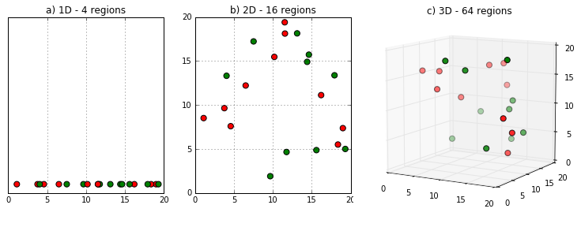
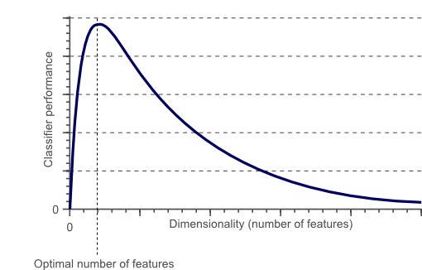
Curse of dimensionality
Why do we need to reduce dimensions?
The curse of dimensionality!
  Higher dimensions implies more empty space →Hence, more data required to maintain a certain data density
  Models learnt in higher dimensions often overfit the data

Slide 4
Dimensionality reduction
Two approaches are available to perform dimensionality reduction
  Feature extraction: creating a subset of new features by combinations of the existing features
  Feature selection: choosing a subset of all the features (the ones more informative)
More complicated methods, Less commonly used
Easier to compute, Widely used, PCA, LDA
http://courses.cs.tamu.edu/rgutier/cs790_w02/l5.pdf

Slide 5
Feature extraction (or mapping)
In general, the optimal mapping y=f(x) will be a non-linear function
  However, there is no systematic way to generate non-linear transforms
  For this reason, feature extraction is commonly limited to linear transforms: y=Wx
  “Kernel trick” or Neural Networks can be used for non-linear mapping
http://courses.cs.tamu.edu/rgutier/cs790_w02/l5.pdf

Slide 6
Different objectives, different mapping methods
Within the realm of linear feature extraction, two techniques are commonly used
  Principal Components Analysis (PCA)
    uses a signal representation criterion
  Linear Discriminant Analysis (LDA)
    uses a classification criterion
http://courses.cs.tamu.edu/rgutier/cs790_w02/l5.pdf

Slide 7
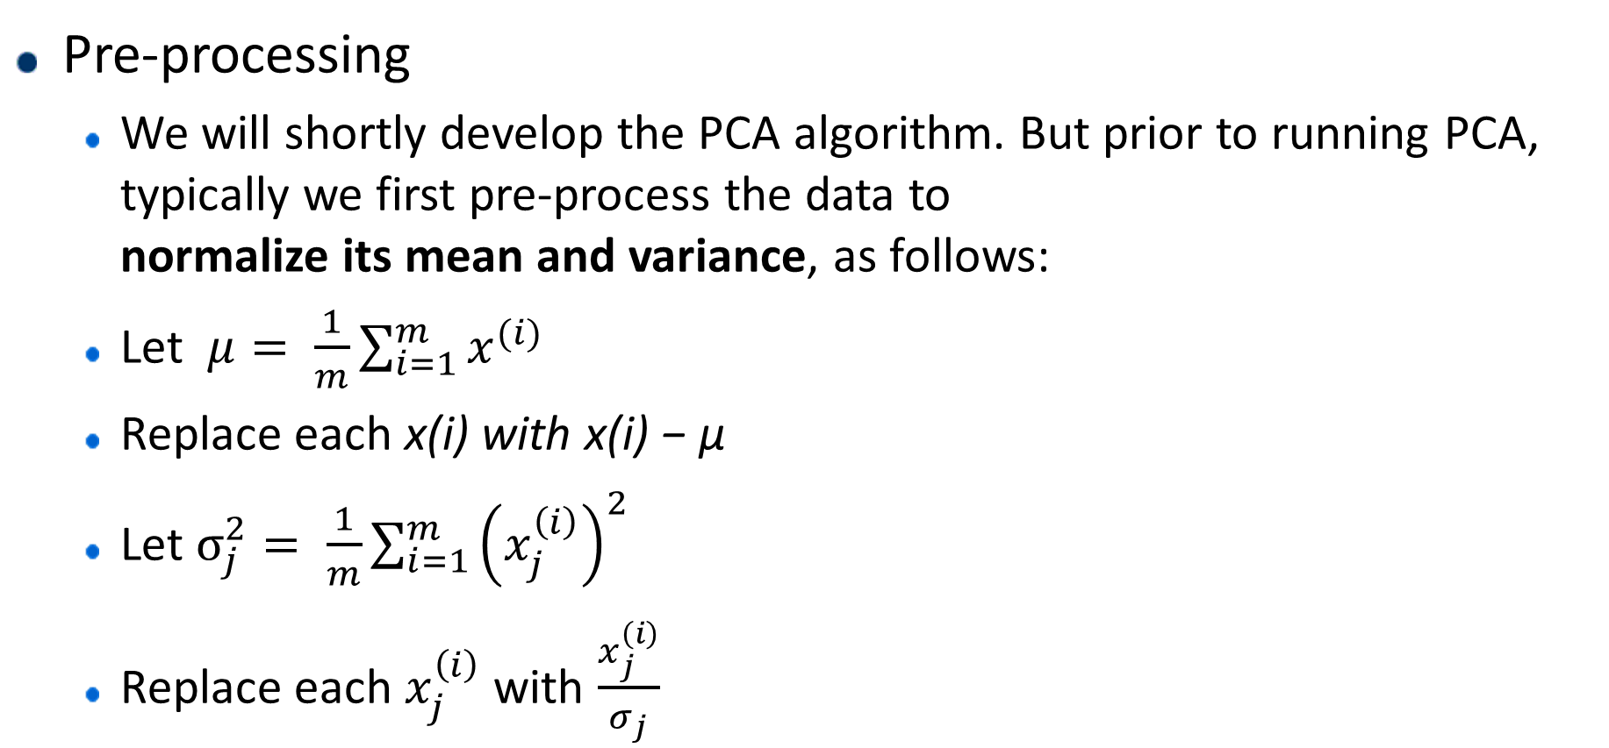
Principal components analysis
Pre-processing
  We will shortly develop the PCA algorithm. But prior to running PCA, typically we first pre-process the data to
  normalize its mean and variance, as follows:
  Let $μ= \frac{1}{m}\sum_{i=1}^{m}{x^{(i)}}$
  Replace each x(i) with x(i) − µ
  Let $σ_{j}^{2}= \frac{1}{m}\sum_{i=1}^{m}{{\left(x_{j}^{\left(i\right)}\right)}^{2}}$
  Replace each $x_{j}^{\left(i\right)}$ with $\frac{x_{j}^{\left(i\right)}}{σ_{j}}$
http://cs229.stanford.edu/notes/cs229-notes10.pdf

Slide 8
Principal components analysis
Find the unit vector u so that when the data is projected onto the direction corresponding to u, the variance of the projected data (u^{T}x) is maximized.
http://cs229.stanford.edu/notes/cs229-notes10.pdf

Slide 9
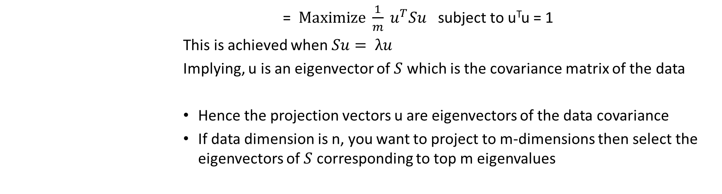
PCA – Mathematical formulation
Maximize
            = $Maximize \frac{1}{m} u^{T}Su$ subject to u^{T}u = 1
            This is achieved when$Su= λu$
            Implying, u is an eigenvector of $S$ which is the covariance matrix of the data
            Hence the projection vectors u are eigenvectors of the data covariance
            If data dimension is n, you want to project to m-dimensions then select the eigenvectors of $S$ corresponding to top m eigenvalues
http://cs229.stanford.edu/notes/cs229-notes10.pdf

Slide 10
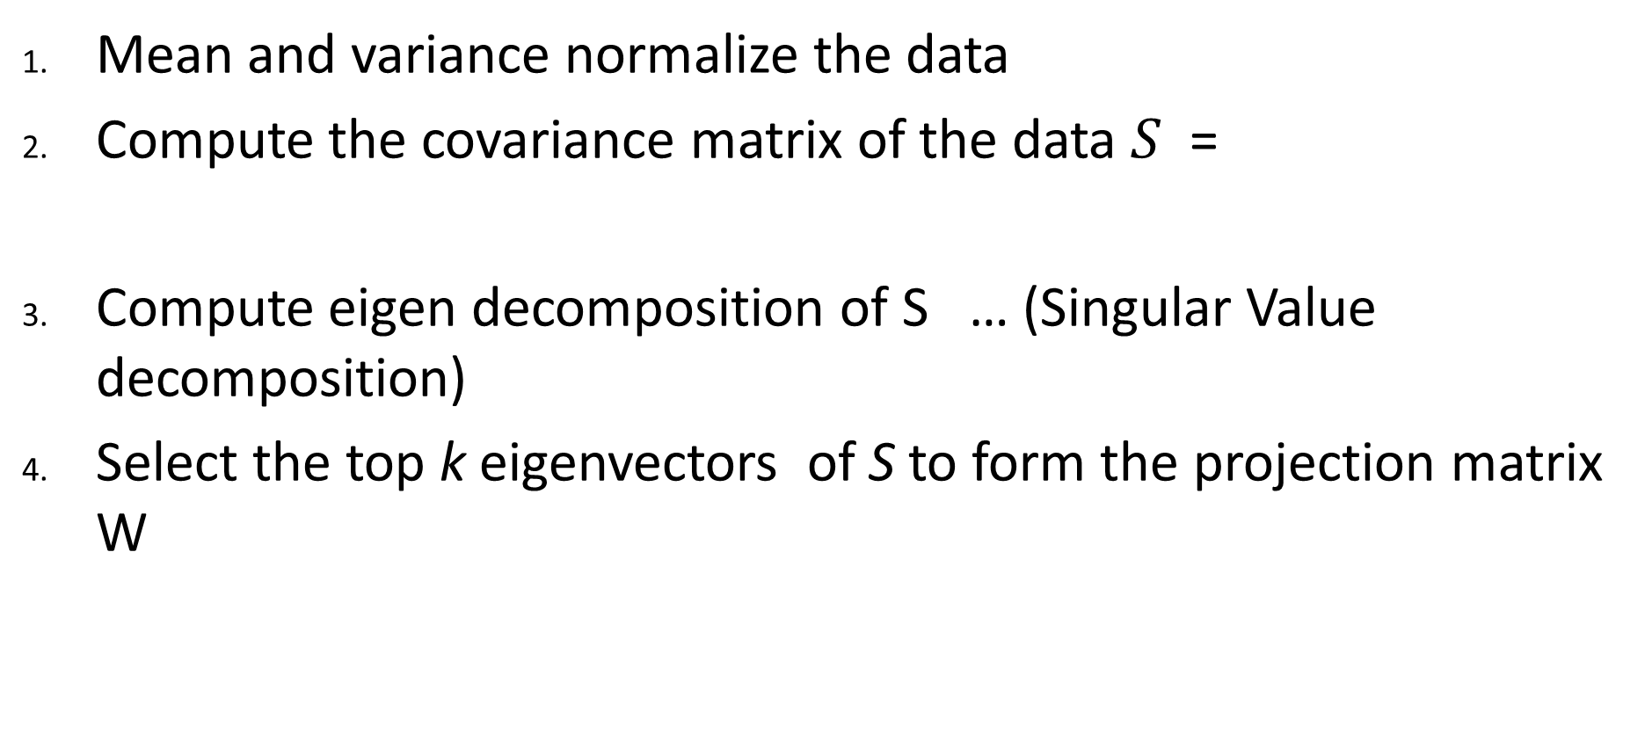

Steps for PCA
Mean and variance normalize the data
Compute the covariance matrix of the data $S$ =
Compute eigen decomposition of S … (Singular Value decomposition)
Select the top k eigenvectors of S to form the projection matrix W
Select “k” such that at least 90% of the data variance is explained
$$W=\left({{u_{1}^{T} \atop u_{2}^{T}} \atop \begin{aligned}u_{3}^{T} \\ ⋮ \\ u_{k}^{T}\end{aligned}}\right)$$

Slide 11
Linear Discriminant Analysis
The objective of LDA is to perform dimensionality reduction while preserving as much of the class discriminatory information as possible
Assume we have a set of D-dimensional samples
{x⁽¹⁾, x⁽²⁾, …, x^{(N)}}, N₁ of which belong to class ω₁, and N₂ to class ω₂. We seek to obtain a scalar (1-dimensional) y by projecting the samples x onto a line
y = w^{T}x
If you have c classes, LDA projects the data to (c-1) dimensions
http://courses.cs.tamu.edu/rgutier/cs790_w02/l6.pdf

Slide 12
Defining the Objective of LDA
Good projection vector w – Determined by Measure of separation between the projected features
We could then choose the distance between the projected means as our objective function
However, the distance between the projected means is not a very good measure since it does not take into account the standard deviation within the classes
We define means:
http://courses.cs.tamu.edu/rgutier/cs790_w02/l6.pdf

Slide 13
Defining the Objective of LDA
Hence, the distance between the projected means is not a very good measure
http://courses.cs.tamu.edu/rgutier/cs790_w02/l6.pdf

Slide 14
The LDA objective function
The solution proposed by Fisher is to maximize a function that represents the difference between the means, normalized by a measure of the within-class scatter
For each class we define the scatter, an equivalent of the variance, as
  where the quantity is called the within-class scatter of the projected examples
The Fisher linear discriminant is defined as the linear function w^{T}x that maximizes the criterion function
http://courses.cs.tamu.edu/rgutier/cs790_w02/l6.pdf

Slide 15
Intuitively…
Therefore, we will be looking for a projection where examples from the same class are projected very close to each other and, at the same time, the projected means are as farther apart as possible
http://courses.cs.tamu.edu/rgutier/cs790_w02/l6.pdf

Slide 16
LDA Mathematical formulation
Within class scatter matrix S_{w} in x-space
Projected within class scatter (y-space):
Distance between projected means:
  S_{B} = Between class scatter (in x-space)
http://courses.cs.tamu.edu/rgutier/cs790_w02/l6.pdf

Slide 17
Solving the objective function
Fisher LDA objective function:
Differentiate and equate derivative to 0
Solving the above equation, we get the optimal w as…
-- For two class problem

Slide 18
Generalization of LDA for C-classes
Recall that we are looking for a projection that maximizes the ratio of between-class to within-class scatter. Since the projection is no longer a scalar (it has C-1 dimensions), we then use the determinant of the scatter matrices to obtain a scalar objective function:
Maximizing J(W) w.r.t. W, we get…

Slide 19
Limitations of LDA
LDA produces at most C-1 feature projections
  If the classification error estimates establish that more features are needed, some other method must be employed to provide those additional features
LDA is a parametric method since it assumes unimodal Gaussian likelihoods
LDA will fail when the discriminatory information is not in the mean but rather in the variance of the data

Slide 20
Data Visualization
Data of higher dimensions (>3) are hard to visualize
Dimensionality reduction helps project data to lower dimensions for visualization
LDA and PCA aren’t useful for reliable visualization of data
Criteria for visualization:
  Preserves the structure of the high dimensional data
  Neighborhoods in projected data represent actual data neighborhoods

Slide 21
Multidimensional Scaling (MDS)
MDS slides from ETH-Z
https://stat.ethz.ch/education/semesters/ss2012/ams/slides/v4.1.pdf

Slide 22
T-SNE
http://www.slideshare.net/david.kh/visualizing-data-using-tsne

Slide 23
http://www.slideshare.net/david.kh/visualizing-data-using-tsne

Slide 24
Cost function of t-SNE
http://www.slideshare.net/david.kh/visualizing-data-using-tsne

Slide 25
Strengths and limitations of t-SNE
Strengths:
  t-SNE is an effective method to visualize a complex datasets
  t-SNE exposes natural clusters
  Implemented in many languages
  Scalable with O(NlogN) version
Limitations
  Sensitive to the curse of the intrinsic dimensionality of the data due to local nature of t-SNE
  Not guaranteed to converge to a global optimum of its cost function.
  Different initializations result in different results

Slide 26
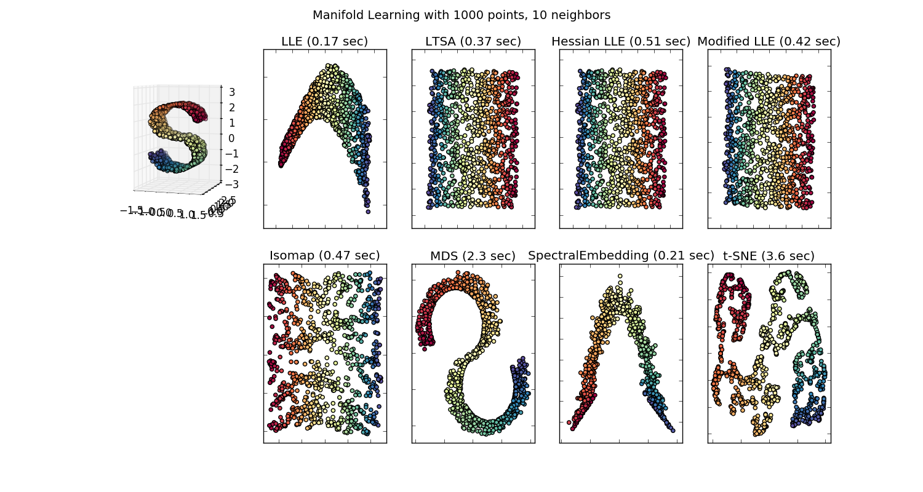
Comparison of Manifold learning techniques

Slide 27
References
http://courses.cs.tamu.edu/rgutier/cs790_w02/l5.pdf
http://scikit-learn.org/stable/auto_examples/manifold/plot_compare_methods.html
T-SNE slides: http://www.slideshare.net/david.kh/visualizing-data-using-tsne
Multidimensional Scaling: https://stat.ethz.ch/education/semesters/ss2012/ams/slides/v4.1.pdf

