Slide 1
Hidden Markov Models for speech recognition
Ganesh Sivaraman

Slide 2
Overview
Speech as a sequence of phonemes
What are triphones and why are they needed?
Markov chains
Properties of Markov chains
Definition of Hidden Markov models
Examples
Three main problems of HMMs
Solutions to the three problems of HMMs
Applying HMMs to speech recognition
A simple isolated word recognition system

Slide 3
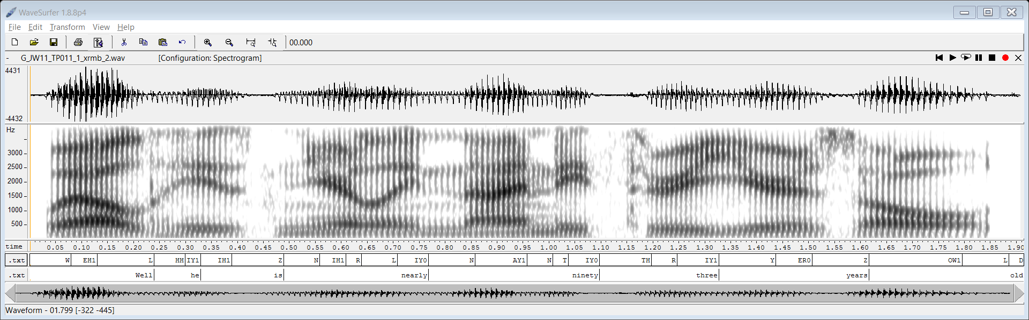
Speech as a sequence of phonemes

Slide 4
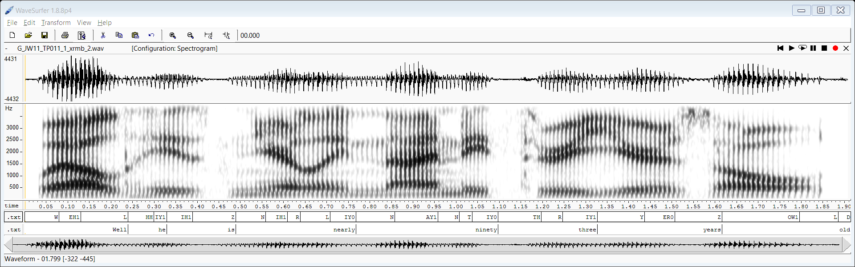
Speech as a phoneme sequence – Monophone modeling
“Hello World”
hello + world
Speech Recognition
sil+hh+ah+l+ow+w+er+l+d+sil

Slide 5
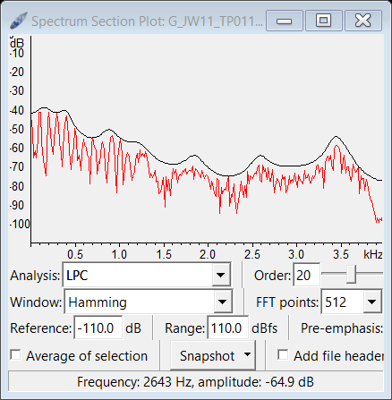
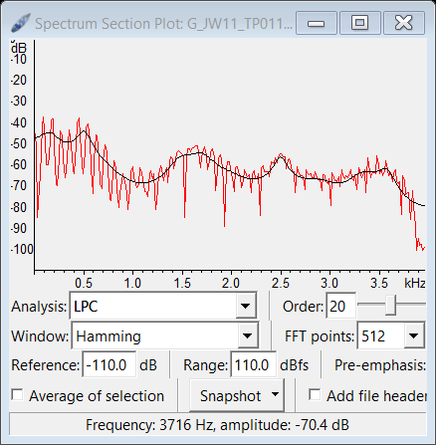
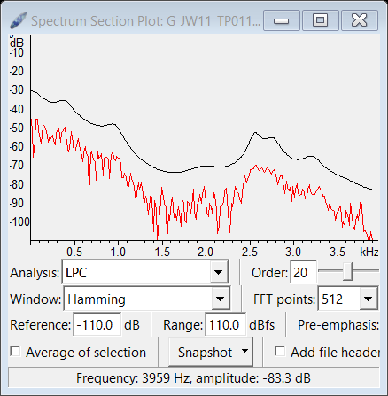
Context dependent variability of phonemes
eh-l-hh
r-l-iy
ow-l-d

Slide 6
Speech as a sequence of triphones – Triphone modeling
Infinitely many
“Hello World”
Language Model
Several thousands or millions based on vocabulary of the system
hello + world
Pronunciation dictionary
Speech Recognition
Around 40-60 for
American English
sil+hh+ah+l+ow+w+er+l+d+sil
Triphone to monophone transducer
Numerically around 64000-216000
But restricted to around 1000~6000
“sil+/sil-hh-ah/+/hh-ah-l/+/ah-l-ow/+
/l-ow-w/+/er-w-l/+/l-er-d/+/er-l-d/+/l-d-sil/+sil
Acoustic model (HMM/DNN)

Slide 7
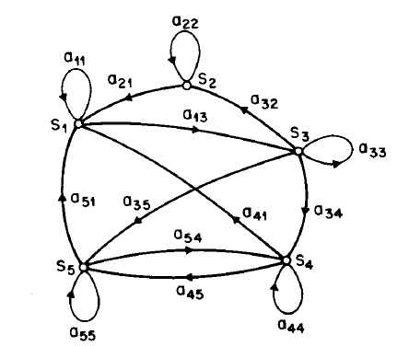
Markov Chains
S₁, S₂,…S₅ – States of the Markov chain
q_{t} = State of Markov chain at time t

Slide 8
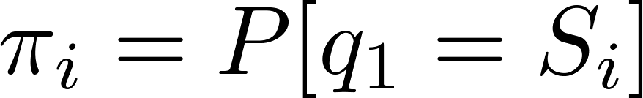
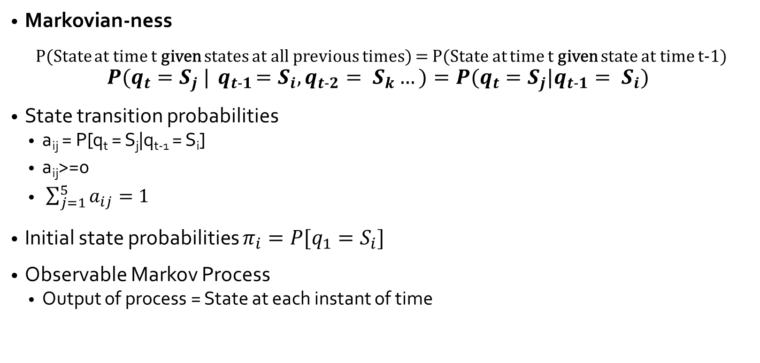
Properties of a Markov chain
Markovian-ness
P(State at time t given states at all previous times) = P(State at time t given state at time t-1)
$$P(q_{t}=S_{j} |{ q}_{t−1}=S_{i}, q_{t−2}= S_{k}…)=P(q_{t}=S_{j}|q_{t−1}= S_{i})$$
State transition probabilities
  a_{ij} = P[q_{t} = S_{j}|q_{t-1} = S_{i}]
  a_{ij}>=0
  $\sum_{j=1}^{5}{a_{ij}}=1$
Initial state probabilities $π_{i}=P[q_{1}=S_{i}]$
Observable Markov Process
  Output of process = State at each instant of time

Slide 9


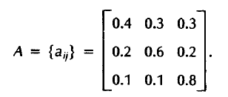
Example of Observable Markov Process
S1
S2
S3
Weather any day is characterized by one of the 3 states
State Transition probabilities:
Given that day1 is Sunny
What is the probability that the weather in the next 7 days will be-
Stated formally, defining the observation sequence as
O = {S3,S3, S3, S1, S1, S3, S2, S3} for times t = 1,2…8
Determine P(O | Model)

Slide 10
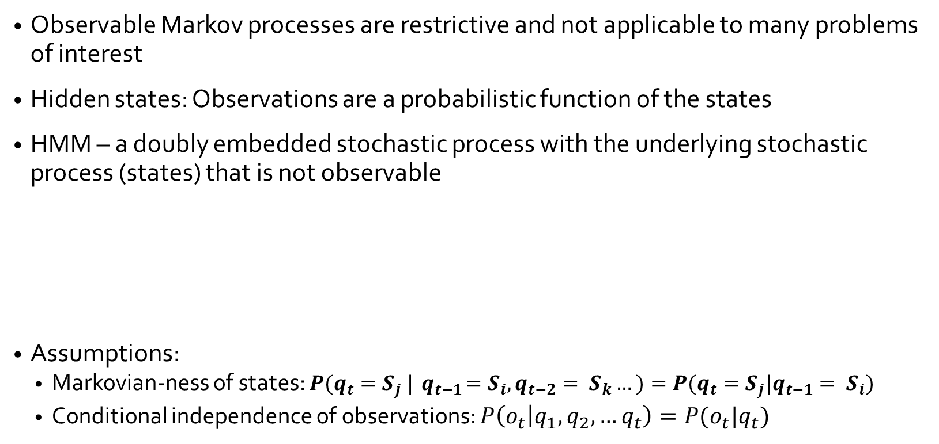
Hidden Markov Models
Observable Markov processes are restrictive and not applicable to many problems of interest
Hidden states: Observations are a probabilistic function of the states
HMM – a doubly embedded stochastic process with the underlying stochastic process (states) that is not observable
Assumptions:
  Markovian-ness of states: $P(q_{t}=S_{j} |{ q}_{t−1}=S_{i}, q_{t−2}= S_{k}…)=P(q_{t}=S_{j}|q_{t−1}= S_{i})$
  Conditional independence of observations: $P\left(o_{t} | q_{1},q_{2},…q_{t}\right)=P(o_{t}|q_{t})$
q₁ → q₂ → q₃ → q₄ →…
o₁
o₂
o₃
o₄

Slide 11
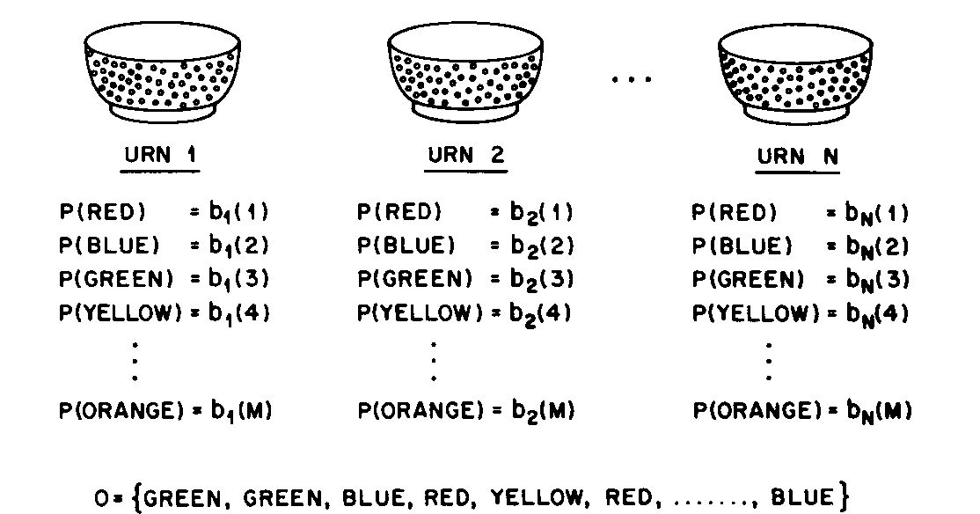
Hidden Markov Model
Modeling Example 2
Urn and Ball Model

Slide 12
Formal Definition of HMM
Number of States = N
  S = {S₁, S₂, …, S_{N}}
  State at time t = q_{t}
Observation symbols – M symbols (can be continuous values)
  V = {v₁, v₂, …, v_{M}}
  Example: Number of distinct colored balls in the urns

Slide 13
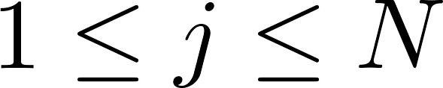
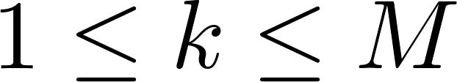
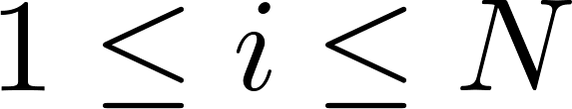

Formal Definition of HMM
State transition probability distribution
  a_{ij} = P[q_{t+1} = S_{j} | q_{t} = S_{i}] 1<=i,j <= N
  A = {a_{ij}}
  $\sum_{j=1}^{N}{a_{ij}}=1$
Observation symbol probability
  b_{j}(k) = P[v_{k} at t | q_{t} = S_{j}]
  B = {b_{j}(k)}
Initial state distribution π = {π_{i}}
  π_{i} = P[q₁ = S_{i}]

Slide 14
HMM as a generator
Given appropriate values of N,M,A,B and π, the HMM can be used as a generator to give an observation sequence O=O₁…O_{T} as follows-
  Choose the initial state q1 according to the initial state distribution π
  Set t = 1
  Choose the t^{th} observation O_{t} according to the observation probability distribution in state q_{t}
  Choose the next state q_{t+1} according to the transition probability distribution in state q_{t}
  Increment t and return to step (3), or stop.

Slide 15
Three fundamental problems of HMM
Likelihood: Given a HMM model, what is the probability of an observation sequence?
Decoding: Given a HMM model and an observation sequence, what is the best sequence of model states ?
Learning: Given a set of observations and the corresponding sequence of states of a HMM, what are the optimum values of the HMM parameters?

Slide 16
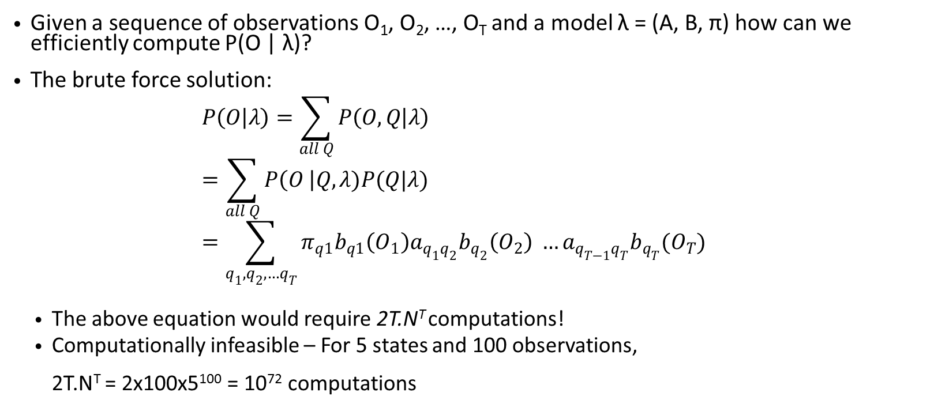
Solution to Problem 1 – Likelihood/Scoring
Given a sequence of observations O₁, O₂, …, O_{T} and a model λ = (A, B, π) how can we efficiently compute P(O | λ)?
The brute force solution:
  $$P\left(O | λ\right)=\sum_{all Q}{P\left(O,Q | λ\right)} \\ =\sum_{all Q}{P\left(O \right|Q,λ)P(Q|λ) } \\ =\sum_{q_{1},q_{2},…q_{T}}{π_{q1}b_{q1}\left(O_{1}\right)a_{q_{1}q_{2}}b_{q_{2}}\left(O_{2}\right) …a_{q_{T−1}q_{T}}b_{q_{T}}(O_{T})}$$
  The above equation would require 2T.N^{T} computations!
  Computationally infeasible – For 5 states and 100 observations,
  2T.N^{T} = 2x100x5¹⁰⁰ = 10⁷² computations

Slide 17
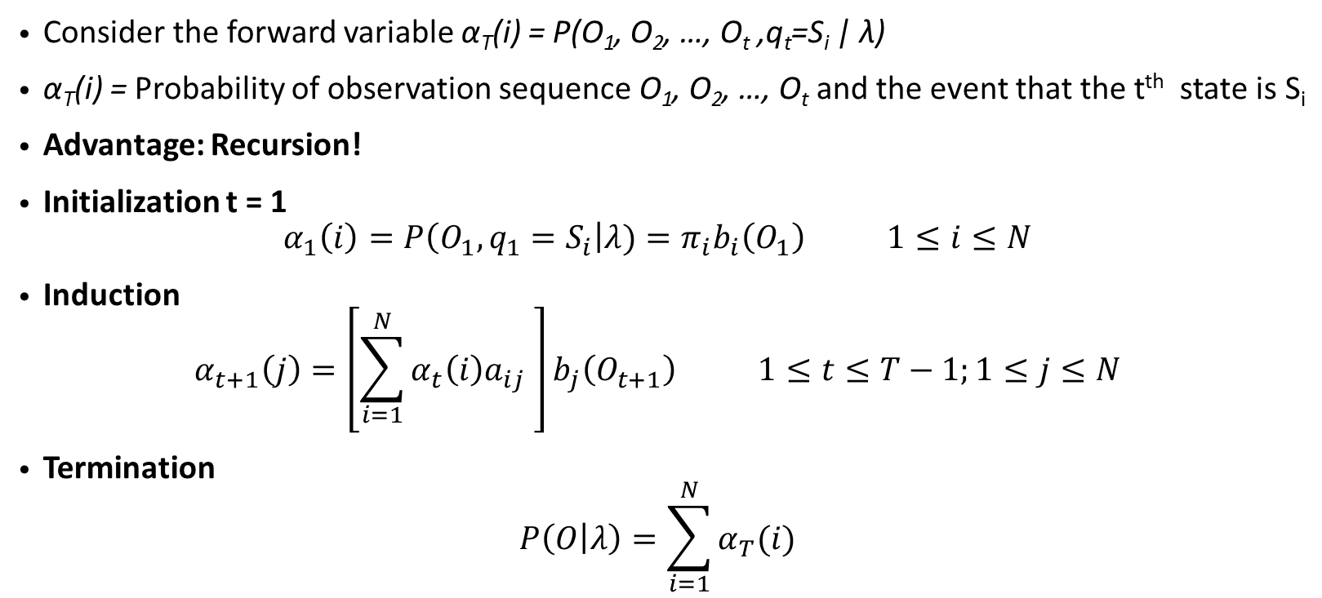
Efficient solution for problem 1 –
The forward procedure
Consider the forward variable α_{T}(i) = P(O₁, O₂, …, O_{t} ,q_{t}=S_{i} | λ)
α_{T}(i) = Probability of observation sequence O₁, O₂, …, O_{t} and the event that the t^{th} state is S_{i}
Advantage: Recursion!
Initialization t = 1
$$α_{1}\left(i\right)=P\left(O_{1}, q_{1}=S_{i}\right|λ)=π_{i}b_{i}\left(O_{1}\right) 1≤i≤N$$
Induction
$$α_{t+1}\left(j\right)=\left[\sum_{i=1}^{N}{α_{t}\left(i\right)a_{ij} }\right]b_{j}\left(O_{t+1}\right) 1≤t≤T−1;1≤j≤N$$
Termination
$$P\left(O | λ\right)=\sum_{i=1}^{N}{α_{T}(i)}$$

Slide 18
Forward recursion: Trellis structure

Slide 19
Overall Lattice structure
…….
…….
…….

Slide 20
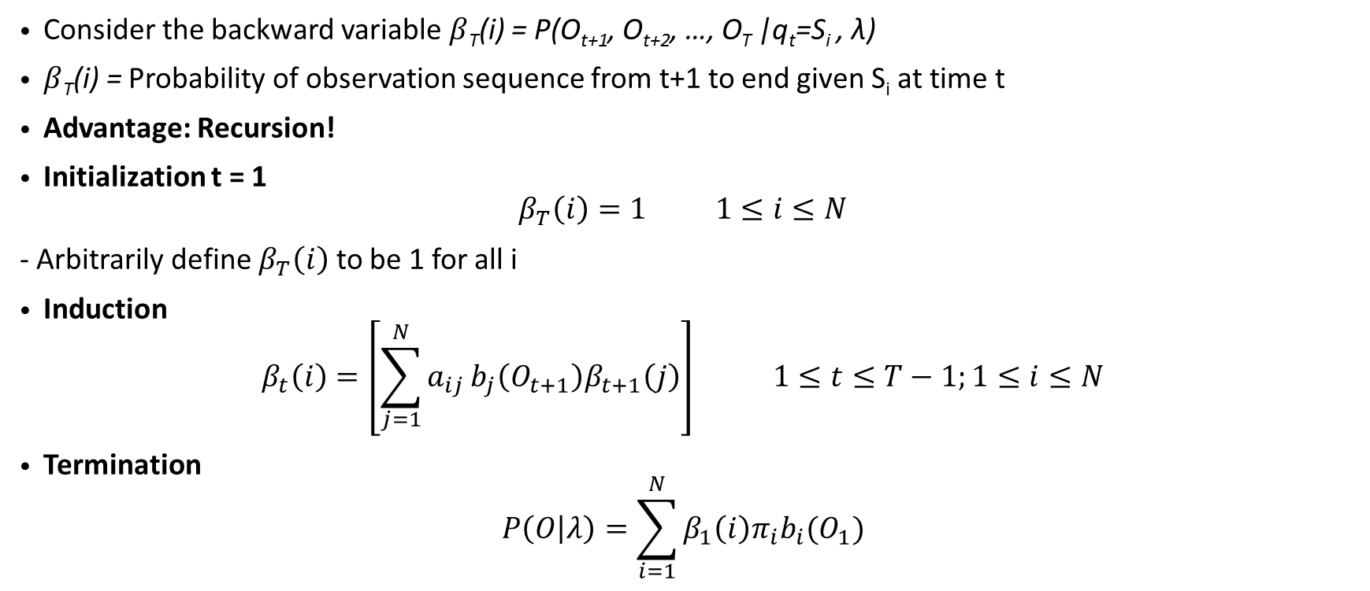
The backward procedure
(used for problem 3)
Consider the backward variable $β$_{T}(i) = P(O_{t+1}, O_{t+2}, …, O_{T} |q_{t}=S_{i} , λ)
$β$_{T}(i) = Probability of observation sequence from t+1 to end given S_{i} at time t
Advantage: Recursion!
Initialization t = 1
$$β_{T}\left(i\right)=1 1≤i≤N$$
- Arbitrarily define $β_{T}\left(i\right)$ to be 1 for all i
Induction
$$β_{t}\left(i\right)=\left[\sum_{j=1}^{N}{a_{ij}}b_{j}\left(O_{t+1}\right)β_{t+1}\left(j\right)\right] 1≤t≤T−1;1≤i≤N$$
Termination
$$P\left(O | λ\right)=\sum_{i=1}^{N}{β_{1}\left(i\right)π_{i}b_{i}(O_{1})}$$

Slide 21
Backward trellis

Slide 22
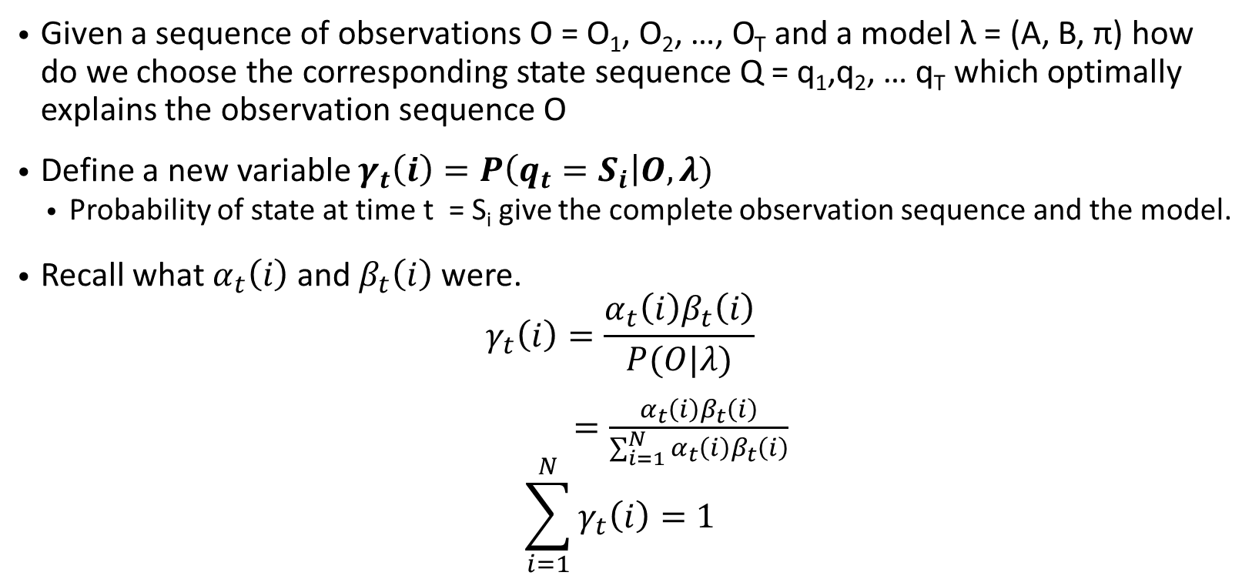
Solution to problem 2 - Decoding
Given a sequence of observations O = O₁, O₂, …, O_{T} and a model λ = (A, B, π) how do we choose the corresponding state sequence Q = q₁,q₂, … q_{T} which optimally explains the observation sequence O
Define a new variable $γ_{t}\left(i\right)=P\left(q_{t}=S_{i}\right|O,λ)$
  Probability of state at time t = S_{i} give the complete observation sequence and the model.
Recall what $α_{t}\left(i\right)$ and $β_{t}\left(i\right)$were.
$$γ_{t}\left(i\right)=\frac{α_{t}\left(i\right)β_{t}\left(i\right)}{P(O|λ)}$$
$=\frac{α_{t}\left(i\right)β_{t}\left(i\right)}{\sum_{i=1}^{N}{α_{t}\left(i\right)β_{t}\left(i\right)}}$
$$\sum_{i=1}^{N}{γ_{t}\left(i\right)}=1$$

Slide 23
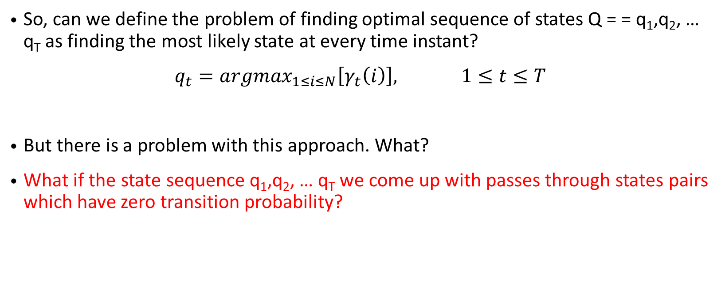
Formulating the optimality criterion
So, can we define the problem of finding optimal sequence of states Q = = q₁,q₂, … q_{T} as finding the most likely state at every time instant?
$q_{t}=argmax_{1≤i≤N}\left[γ_{t}\left(i\right)\right], 1≤t≤T$
But there is a problem with this approach. What?
What if the state sequence q₁,q₂, … q_{T} we come up with passes through states pairs which have zero transition probability?

Slide 24
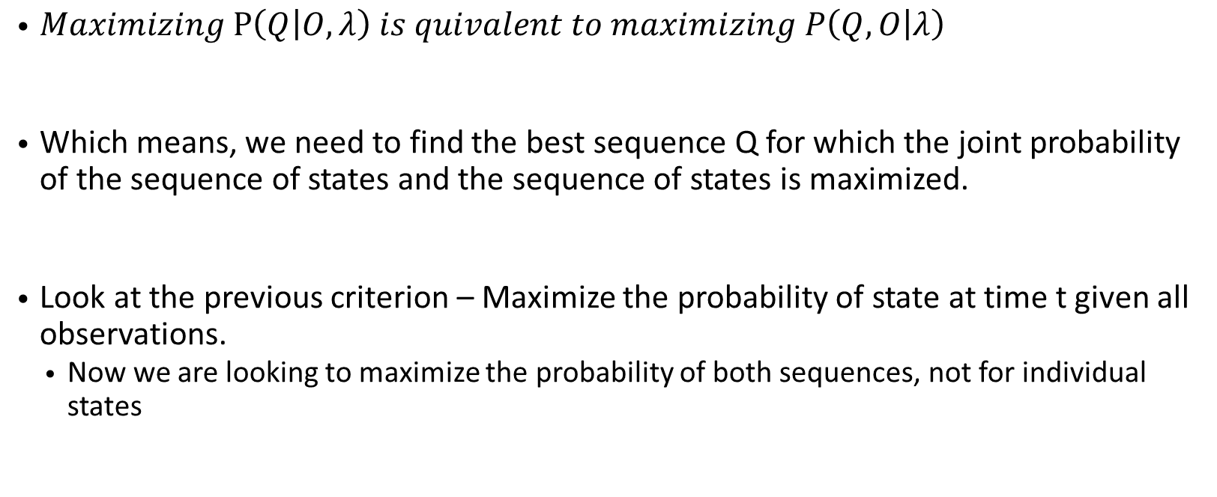
Reformulating the optimality criterion
$Maximizing P\left(Q | O,λ\right) is quivalent to maximizing P\left(Q,O | λ\right)$
Which means, we need to find the best sequence Q for which the joint probability of the sequence of states and the sequence of states is maximized.
Look at the previous criterion – Maximize the probability of state at time t given all observations.
  Now we are looking to maximize the probability of both sequences, not for individual states

Slide 25
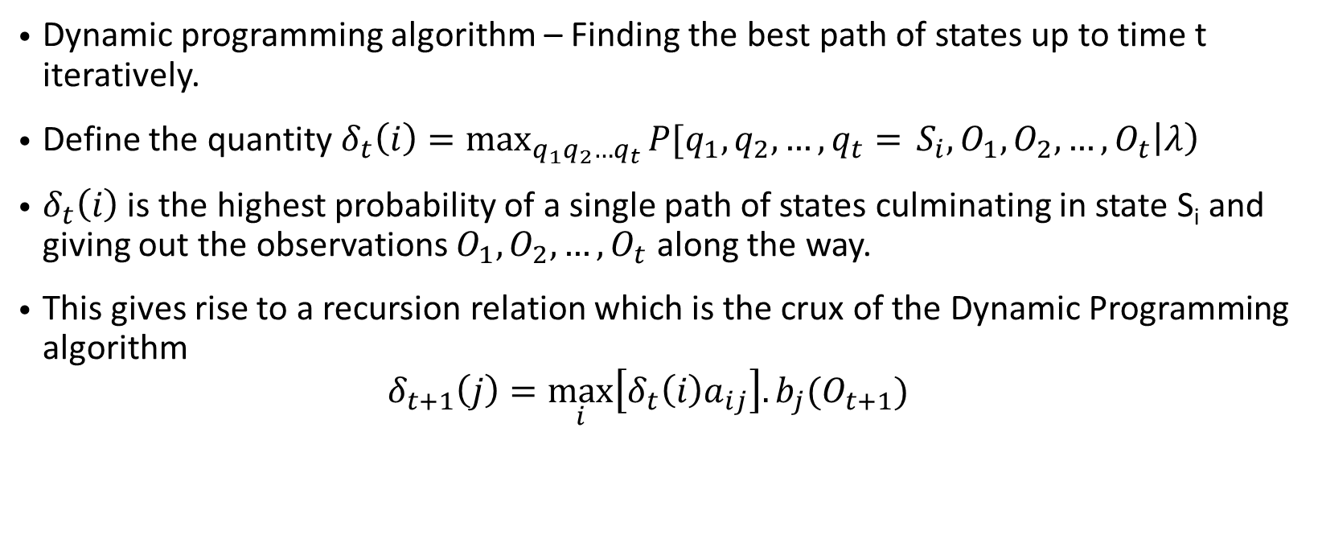
Viterbi Algorithm
Dynamic programming algorithm – Finding the best path of states up to time t iteratively.
Define the quantity $δ_{t}\left(i\right)=\max_{q_{1}q_{2}…q_{t}}{P[q_{1},q_{2},…, q_{t}=} S_{i}, O_{1},O_{2},…, O_{t}\left|λ\right)$
$δ_{t}\left(i\right)$ is the highest probability of a single path of states culminating in state S_{i} and giving out the observations $O_{1},O_{2},…, O_{t}$ along the way.
This gives rise to a recursion relation which is the crux of the Dynamic Programming algorithm
$$δ_{t+1}\left(j\right)=\max_{i}\left[δ_{t}\left(i\right)a_{ij}\right].b_{j}(O_{t+1})$$

Slide 26
Viterbi Algorithm
Notes:
\Zeta_t (j) is like a vector storing the index of states along the best path leading to state j at time t
It wgives which is the most likely state at time t-1 given that state at time t = Sj
Backtracking allows you to use the stored Zetas to decode the best state sequence

Slide 27
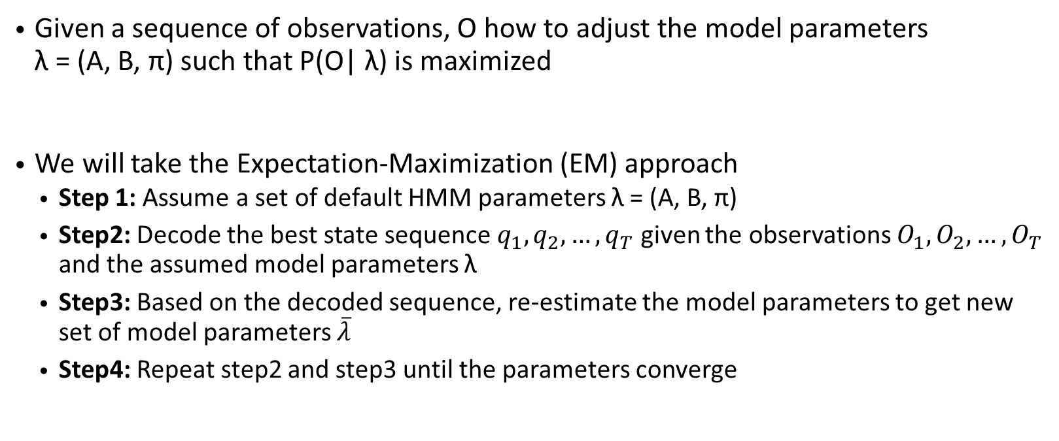
Solution to problem 3 - Training
Given a sequence of observations, O how to adjust the model parameters
λ = (A, B, π) such that P(O| λ) is maximized
We will take the Expectation-Maximization (EM) approach
  Step 1: Assume a set of default HMM parameters λ = (A, B, π)
  Step2: Decode the best state sequence $q_{1},q_{2},…, q_{T}$ given the observations $O_{1},O_{2},…, O_{T}$ and the assumed model parameters λ
  Step3: Based on the decoded sequence, re-estimate the model parameters to get new set of model parameters $\overline{λ}$
  Step4: Repeat step2 and step3 until the parameters converge

Slide 28

Training
Define another quantity $ξ_{t}\left(i, j\right)=P\left(q_{t}=S_{i}, q_{t+1}=S_{j}\right|O, λ)$

Slide 29
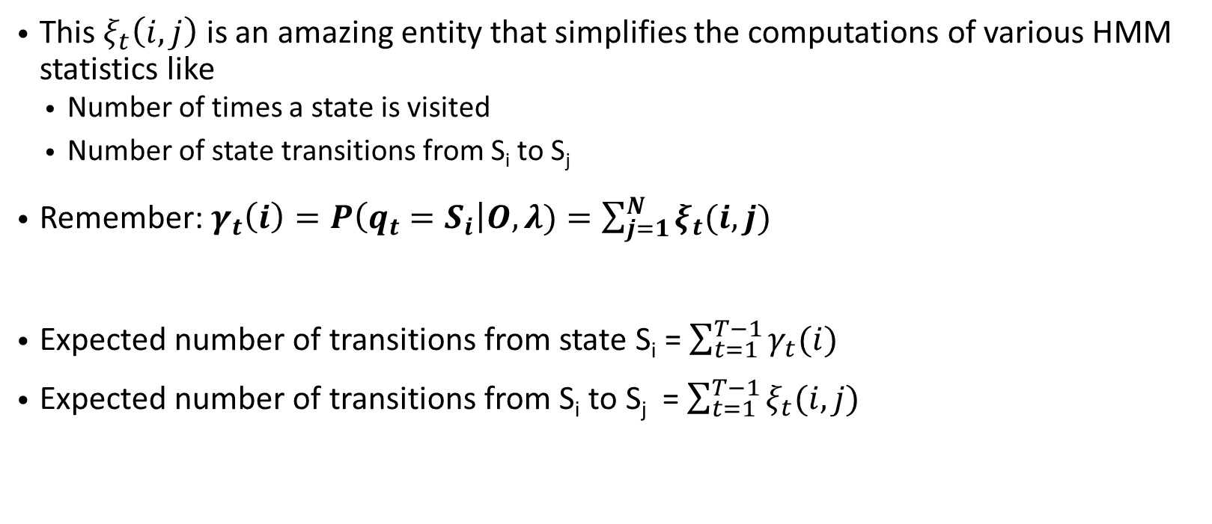
Computing statistics
This $ξ_{t}\left(i, j\right)$ is an amazing entity that simplifies the computations of various HMM statistics like
  Number of times a state is visited
  Number of state transitions from S_{i} to S_{j}
Remember: $γ_{t}\left(i\right)=P\left(q_{t}=S_{i}\right|O,λ)=\sum_{j=1}^{N}{ξ_{t}(i, j)}$
Expected number of transitions from state S_{i} = $\sum_{t=1}^{T−1}{γ_{t}(i)}$
Expected number of transitions from S_{i} to S_{j} = $\sum_{t=1}^{T−1}{ξ_{t}(i,j)}$

Slide 30
Updating HMM parameters from statistics

Slide 31
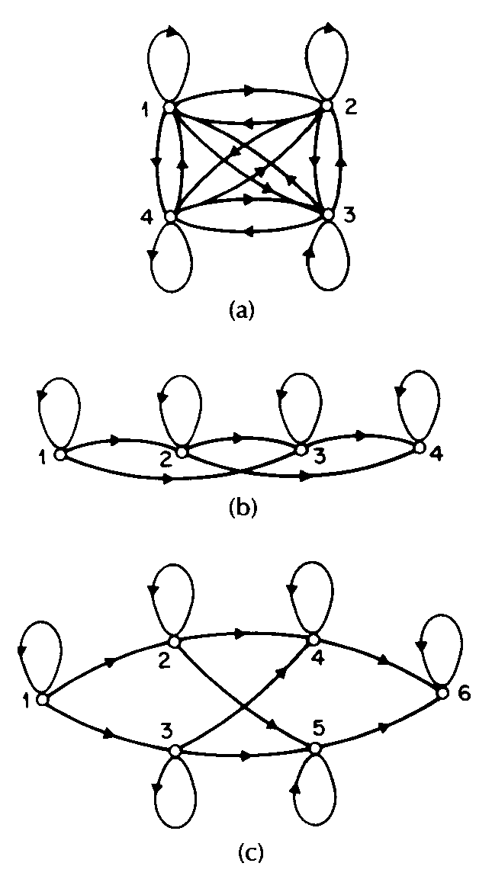
Types of HMM
4 state ergoic
Most suited for Automatic Speech Recognition
4 state left-right
6 state parallel left-right

Slide 32
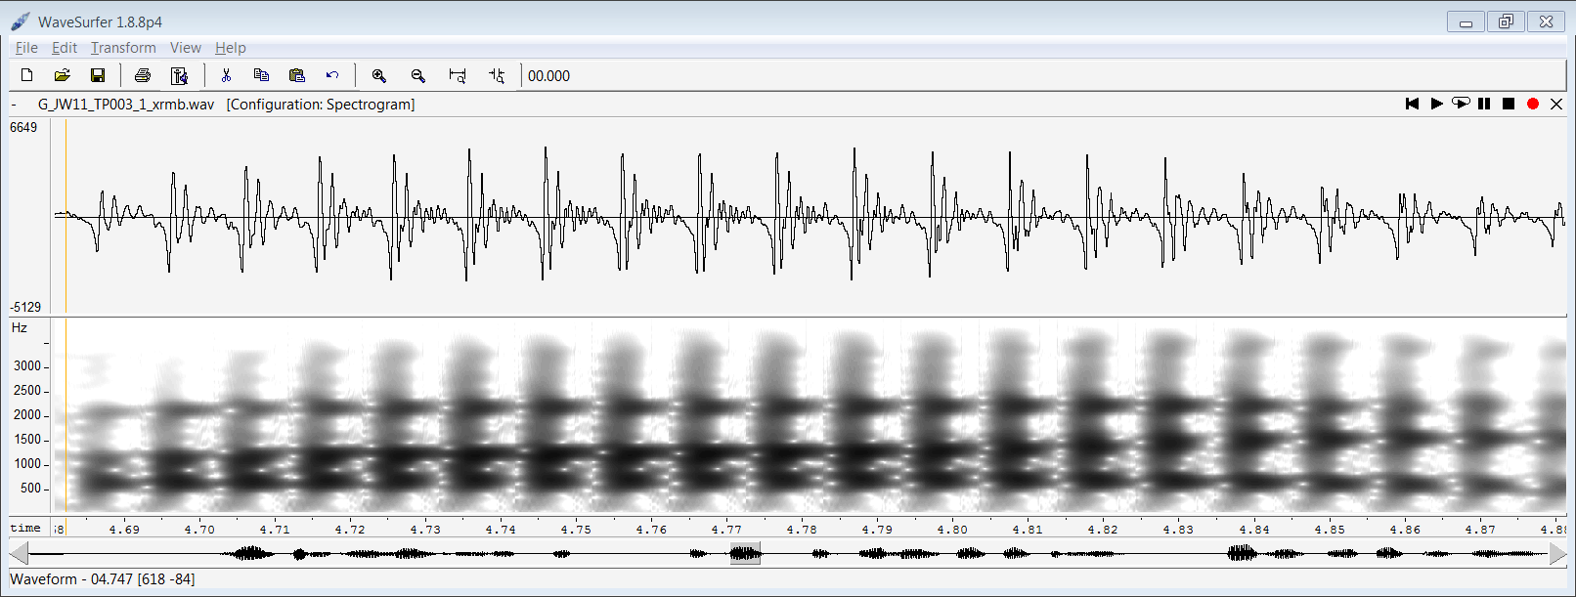
Application to speech recognition
HMM states:
1
2
3
Start
End
Note that this is typically made up of multiple frames (25ms) of speech. This may NOT be one frame
Observations:
MFCCs of every frame
Word or Phoneme or Triphone

Slide 33
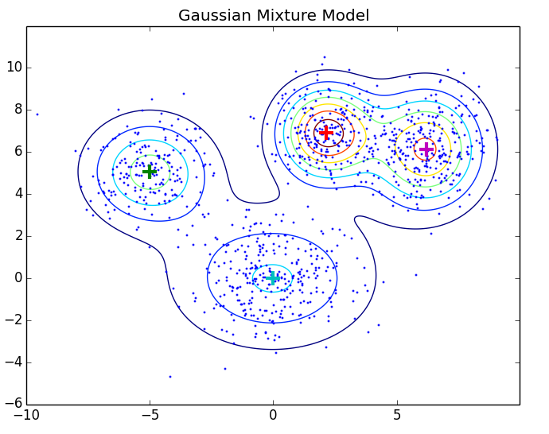
How do we model the MFCC distributions for every state?
GMMs to the rescue! ☺
The observations of each HMM state are modelled by a Gaussian Mixture Model (GMM).
Typically 5 to 10 Gaussians per mixture.

Slide 34
Example Isolated Word recognition system
MFCC Feature extraction

Slide 35
Word recognition training
If I have 100 words and a 5 state HMM model for each word, N = 500 states
Number of HMMs = 100
Probability distribution of observations of every state is a GMM
Number of GMMs = 500
Training phase
  Training data: Isolated word signals along with word labels
  Initialize uniform configuration for HMM states and parameters.
  Iteratively estimate HMM parameters including the GMMs

Slide 36
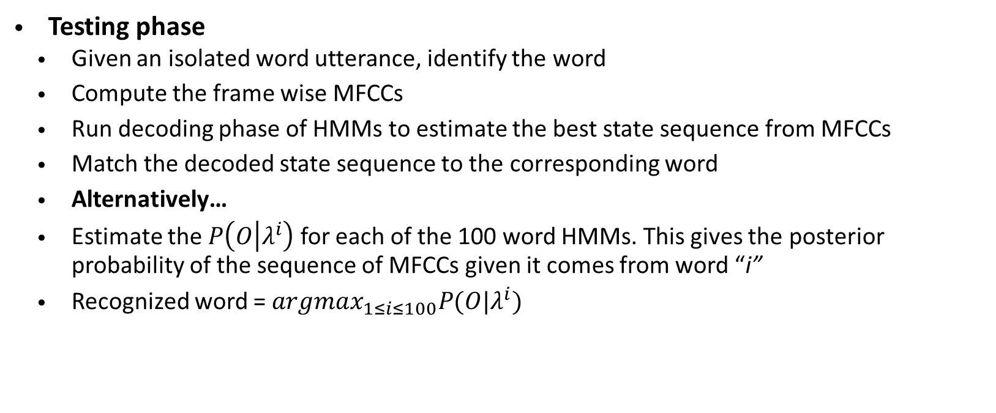
Word recognizer testing
Testing phase
  Given an isolated word utterance, identify the word
  Compute the frame wise MFCCs
  Run decoding phase of HMMs to estimate the best state sequence from MFCCs
  Match the decoded state sequence to the corresponding word
  Alternatively…
  Estimate the $P\left(O | λ^{i}\right)$ for each of the 100 word HMMs. This gives the posterior probability of the sequence of MFCCs given it comes from word “i”
  Recognized word = $argmax_{1≤i≤100}P(O|λ^{i})$

Slide 37
Next Lecture
How does a continuous speech recognition system work?
Drawbacks and limitations of HMMs and their GMM acoustic models
Deep Neural Network as the knight in shining armor for ASR replacing GMMs
Recurrent neural networks for ASR
  Long-Short Term Memory (LSTM) networks
  Bidierctional LSTM networks
Tools for developing ASR
  Kaldi
  Theano/Tensorflow

Slide 38
References
L. R. Rabiner, "A tutorial on hidden Markov models and selected applications in speech recognition," in Proceedings of the IEEE, vol. 77, no. 2, pp. 257-286, Feb 1989.
http://hmmlearn.readthedocs.io/en/latest/index.html

