Slide 1
Vocal tract length normalization for speaker independent acoustic-to-articulatory speech inversion
Ganesh Sivaraman¹, Vikramjit Mitra², Hosung Nam³, Mark Tiede⁴, Carol Espy-Wilson¹
¹University of Maryland College Park, MD, ²SRI International, Menlo Park, CA, ³Department of English Language and Literature, Korea University, Seoul, South Korea, ⁴Haskins Laboratories, New Haven, CT

Slide 2
Overview
Acoustic to Articulatory Speech Inversion
Motivation
Speech inversion system
Dataset used for this work
Speaker acoustic spaces
Vocal tract length normalization
Speaker transformation of training dataset
Experiments
Results
Conclusions

Slide 3
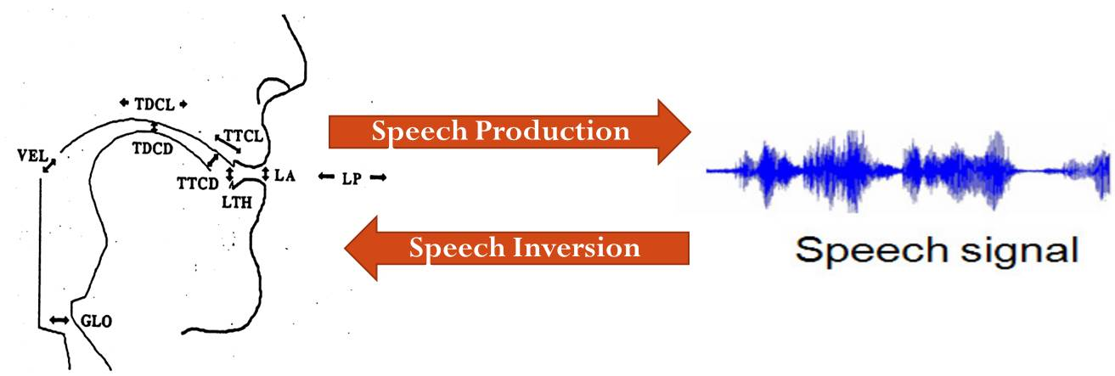
Acoustic to Articulatory Speech Inversion
Challenges
Highly nonlinear and somewhat non-unique mapping from acoustics to articulations (ref)
Different possible representations of articulatory data
Approaches
Codebook based approaches (Schroeter and Sondhi, (1994))
Gaussian Mixture Models (GMM) and Hidden Markov Models (HMMs) (Toda et al., (2004))
Artificial Neural Networks (ANN) (Mitra, (2010))
Notes:
Get rid of this. Include the info in 11

Slide 4
Motivation
Speech inversion systems perform really well in Speaker dependent scenario
However, cross speaker performance is very poor compared to speaker dependent performances
 | Spkr1 (M) | Spkr 2 (F) | Spkr 3 (M) | Spkr 4 (F) | Spkr 5 (F) | Spkr 6 (F) | Spkr 7 (M) | Spkr 8 (M) | Spkr 9 (F) | Spkr10 (M)
Spkr 1 (M) | 0.80 | 0.52 | 0.62 | 0.47 | 0.36 | 0.30 | 0.52 | 0.58 | 0.52 | 0.56
Spkr 2 (F) | 0.53 | 0.78 | 0.50 | 0.61 | 0.56 | 0.49 | 0.33 | 0.41 | 0.60 | 0.47
Spkr 3 (M) | 0.62 | 0.51 | 0.75 | 0.44 | 0.29 | 0.24 | 0.53 | 0.58 | 0.50 | 0.61
Spkr 4 (F) | 0.55 | 0.59 | 0.47 | 0.80 | 0.56 | 0.56 | 0.31 | 0.39 | 0.57 | 0.41
Spkr 5 (F) | 0.44 | 0.55 | 0.29 | 0.59 | 0.74 | 0.64 | 0.13 | 0.17 | 0.50 | 0.34
Spkr 6 (F) | 0.30 | 0.44 | 0.17 | 0.51 | 0.54 | 0.82 | 0.17 | 0.15 | 0.35 | 0.18
Spkr 7 (M) | 0.53 | 0.38 | 0.50 | 0.34 | 0.21 | 0.20 | 0.77 | 0.56 | 0.41 | 0.49
Spkr 8 (M) | 0.58 | 0.49 | 0.60 | 0.38 | 0.23 | 0.13 | 0.59 | 0.78 | 0.52 | 0.60
Spkr 9 (F) | 0.55 | 0.59 | 0.49 | 0.61 | 0.51 | 0.42 | 0.42 | 0.46 | 0.74 | 0.49
Spkr 10 (M) | 0.56 | 0.46 | 0.54 | 0.40 | 0.29 | 0.22 | 0.47 | 0.54 | 0.45 | 0.80

Slide 5
Speech inversion system
Input Speech
MFCC Feature extraction
Contextual window of 160ms
Kalman Smoothing
Tract Variables
Function mapping approach to speech inversion
Artificial neural networks (ANN) suitable for the highly non-linear and non-unique mapping from acoustics to TVs [V.Mitra et al. 2010]
Input features: Contextualized MFCCs (13 coeffs x 17 frames)
Outputs: 6 TVs (LA, LP, TBCL, TBCD, TTCL, TTCD)
Single Hidden layer networks
100 – 500 nodes in hidden layer
Scaled conjugate gradient algorithm for training.

Slide 6
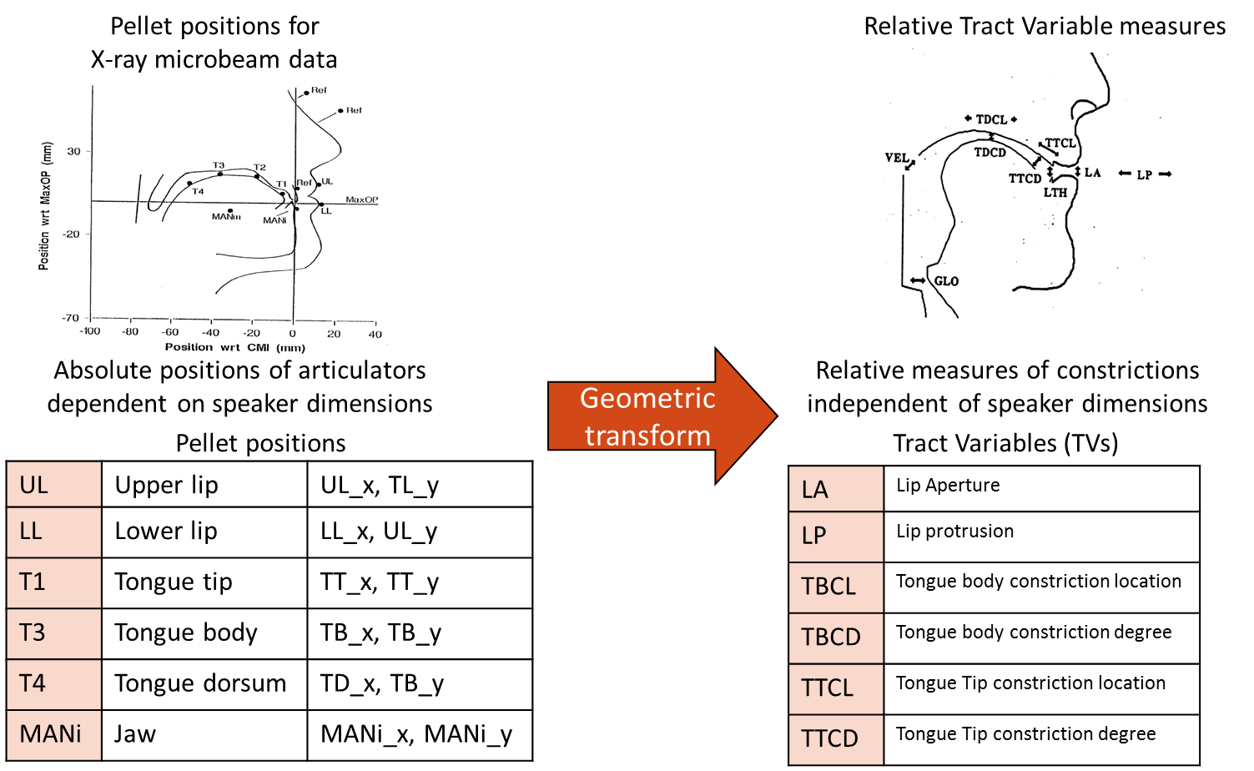
Dataset used for this work
U. Wisconsin X-ray microbeam (XRMB) dataset consisting of 46 different subjects spanning 4 hours of speech and articulatory data.
The pellet trajectories from XRMB dataset are converted to 6 Tract Variables (TVs) using a geometric transformation (H. Nam et.al., 2012)
Data from 10 speakers (5 males and 5 females) were selected for the experiments performed in this paper.

Slide 7
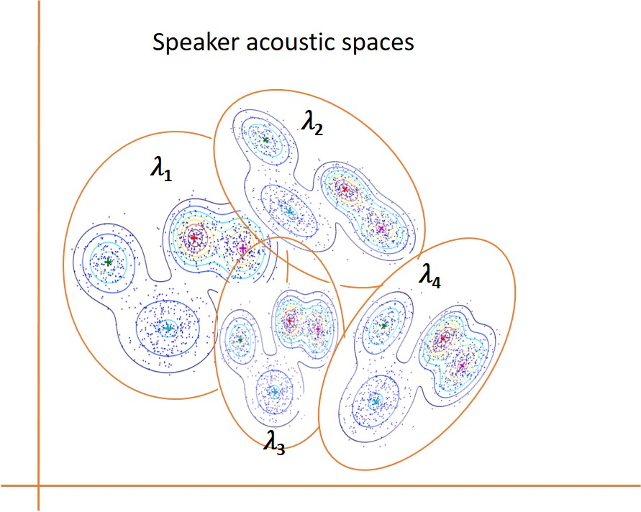
Speaker acoustic spaces
64 Gaussian mixtures to model each speaker’s acoustic space
Feature extraction
Unsupervised GMM training
𝜆_{𝑗} - Speaker S_{j}’s acoustic model
Speaker S_{j}’s acoustic data
39 dimensional MFCC
Such GMM acoustic spaces are trained for each speaker in the dataset

Slide 8
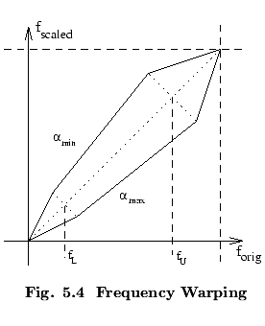
Vocal Tract-length normalization (VTLN)
Frequency domain warping like VTLN to adapt acoustic features of one speaker to another.
Speaker S_{i}’s acoustic features are transformed to speaker S_{j}’s acoustic space using the VTLN parameter $α_{ij}$ decided by a Maximum Likelihood criterion.
$α_{ij}=arg\max_{α}{\sum_{t=1}^{N}{log(P(x_{ijt}|λ_{j},α))} }$

Slide 9
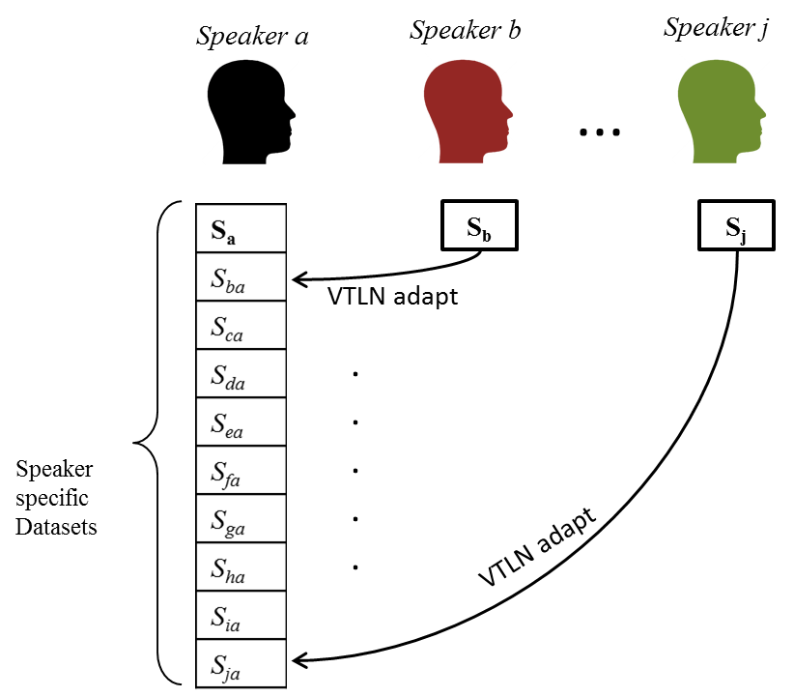
Speaker transformation of training dataset

Slide 10
Various speech inversion systems
System ID | Description
SD | Speaker dependent systems on all 10 speakers
SI | Data from remaining 9 speakers to match the amount of training data of target speaker
SI_VTLN | VTLN transformed Data from remaining 9 speakers to match the amount of training data of target speaker
SD+SI_VTLN | VTLN transformed Data from remaining 9 speakers + Target speaker’s data were randomly sampled to match the amount of training data of target speaker
SI_alldata | All training data from remaining 9 speakers
SI_VTLN_alldata | All VTLN transformed training data from remaining 9 speakers
SD+SI_VTLN_alldata | All VTLN transformed training data from remaining 9 speakers + training data from target speaker

Slide 11
Results
The values in the table show average of the correlations of the 6 estimated TVs with actual TVs.
Speech inversion System | Average amount of Training data (mins) | Spk a | Spk b | Spk c | Spk d | Spk e | Spk f | Spk g | Spk h | Spk i | Spk j | Average
 |  | JW12 | JW14 | JW24 | JW26 | JW27 | JW31 | JW40 | JW45 | JW54 | JW59
 |  | M | F | M | F | F | F | M | M | F | M
SD | 5.68 | 0.80 | 0.78 | 0.75 | 0.80 | 0.74 | 0.82 | 0.77 | 0.78 | 0.74 | 0.80 | 0.78
SI | 5.68 | 0.61 | 0.62 | 0.58 | 0.58 | 0.50 | 0.45 | 0.51 | 0.57 | 0.52 | 0.56 | 0.55
SI_VTLN | 5.68 | 0.66 | 0.61 | 0.59 | 0.69 | 0.58 | 0.58 | 0.61 | 0.60 | 0.64 | 0.65 | 0.62
SD+DI_VTLN | 5.68 | 0.68 | 0.64 | 0.66 | 0.70 | 0.61 | 0.62 | 0.64 | 0.65 | 0.65 | 0.66 | 0.65
SI_alldata | 51.13 | 0.71 | 0.71 | 0.70 | 0.69 | 0.65 | 0.60 | 0.63 | 0.69 | 0.69 | 0.68 | 0.68
SI_VTLN_alldata | 51.13 | 0.74 | 0.73 | 0.73 | 0.78 | 0.69 | 0.69 | 0.70 | 0.72 | 0.70 | 0.74 | 0.72
SD+SI_VTLN_alldata | 56.81 | 0.80 | 0.78 | 0.77 | 0.81 | 0.74 | 0.79 | 0.76 | 0.77 | 0.76 | 0.79 | 0.78

Slide 12
Conclusions
The proposed VTLN based speaker transformation provides 7% improvement in the case when the training data is limited to 5.68mins on an average.
Including a few utterances from target speaker’s training data improves the performance by 2% over Sys2 which is trained on VTLN transformed data
Speaker Dependent system performance is 16% higher than Sys2 which is trained on data from the other 9 speakers.
Adding all available data for training (~51mins) gives a much better performance.
Adding all the training data of the target speaker, as done in the training of Sys3_alldata provides a system that performs as well as the speaker dependent SD systems

Slide 13
References
H. Nam, V. Mitra, M. Tiede, M. Hasegawa-Johnson, C. Espy-Wilson, E. Saltzman, and L. Goldstein, “A procedure for estimating gestural scores from speech acoustics.,” J. Acoust. Soc. Am., vol. 132, no. 6, pp. 3980–9, Dec. 2012.
S. Omid Sadjadi, M. Slaney, and L. Heck, “MSR Identity Toolbox v1.0: A MATLAB Toolbox for Speaker-Recognition Research,” Speech and Language Processing Technical Committee Newsletter, Nov-2013.
J. R. Westbury, “Microbeam Speech Production Database User’'s Handbook,” IEEE Pers. Commun. - IEEE Pers. Commun., 1994.

