Slide 1
Machine Learning basics
Lecture 1

Slide 2
Outline
Overview of Machine Learning (ML) problems
Classification problem
  Naive Bayes
  K-Nearest neighbors
  Logistic regression
  Support Vector Machines
Regression problem
  Ordinary Least squares
  Ridge regression
  Nearest neighbor regression
  Support Vector Regression
Some best practices and ML advice

Slide 3
Machine Learning problems
Supervised learning
  Given a set of labeled input-output pairs D = {(x_{i},y_{i})}_{i=1}^{N} learn a mapping from x → y
  Classification, Regression
Unsupervised learning
  Given only a set of inputs D = {(x_{i})}_{i=1}^{N} find interesting patterns in the data
  Clustering
Reinforcement learning
  Best series of actions towards a particular goal given a reward and punishment signal

Slide 4
Classification
Given a set of input-output pairs D = {(x_{i},y_{i})}_{i=1}^{N} where y_{i} are discrete {1,…,C} classes.
Learn model y = f(X) that predicts the class from input features X
Parametric and non-parametric methods
  Parametric – Generative models, naïve Bayes
  Non-parametric – kNN, SVM, Neural networks

Slide 5
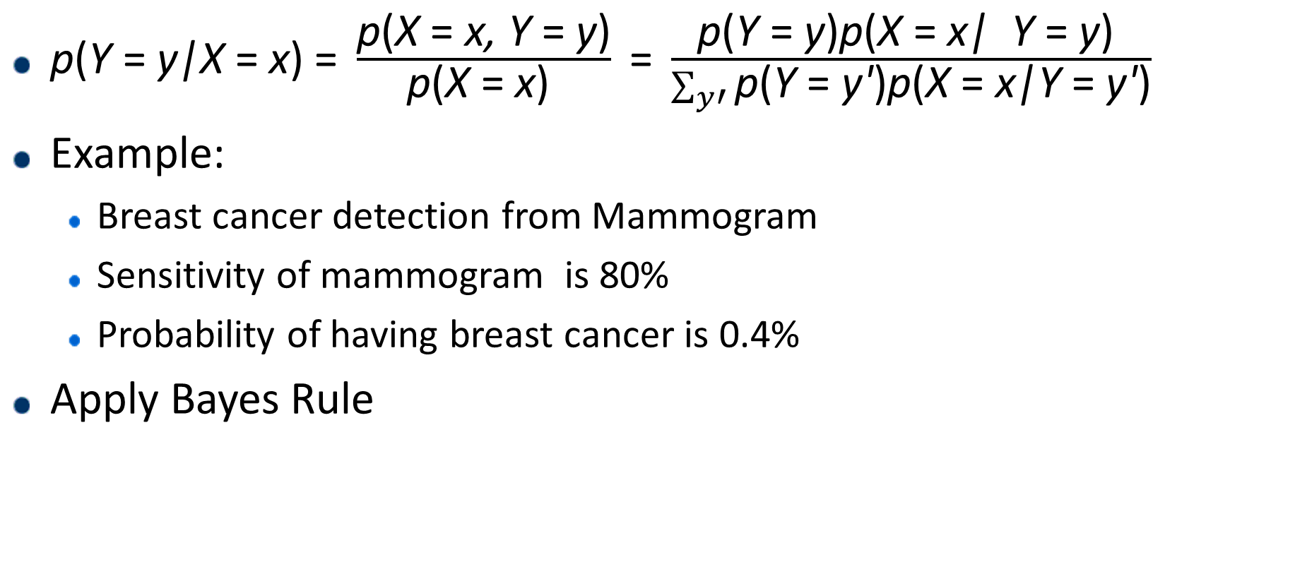
Bayes rule
$\text{p}\text{(}\text{Y} \text{= }\text{y}\text{|}\text{X} \text{= }\text{x}\text{) =} \frac{\text{p}\text{(}\text{X} \text{= }\text{x}\text{, }\text{Y} \text{= }\text{y}\text{)}}{\text{p}\text{(}\text{X} \text{= }\text{x}\text{) }} \text{=} \frac{\text{p}\text{(}\text{Y} \text{= }\text{y}\text{)}\text{p}\text{(}\text{X} \text{= }\text{x}\text{| } \text{Y} \text{= }\text{y}\text{) }}{\sum_{y′}{\text{p}\text{(}\text{Y} \text{= }\text{y}\text{′}\text{)}\text{p}\text{(}\text{X} \text{= }\text{x}\text{|}\text{Y} \text{= }\text{y}\text{′}\text{)}}}$
Example:
  Breast cancer detection from Mammogram
  Sensitivity of mammogram is 80%
  Probability of having breast cancer is 0.4%
Apply Bayes Rule

Slide 6
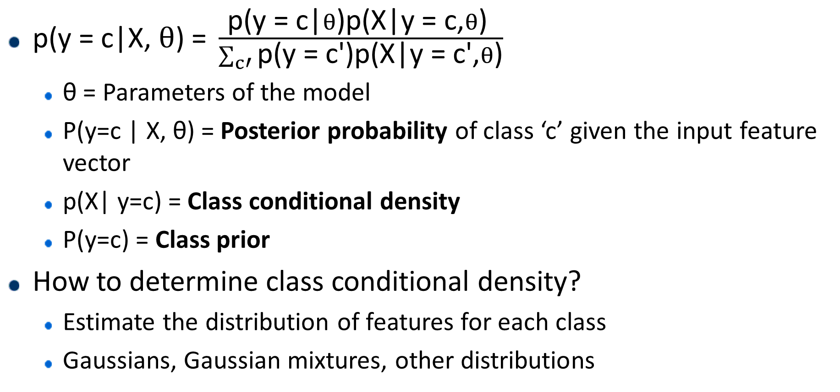
Generative classifiers
$\text{p}\text{(}\text{y}\text{ = }\text{c}\text{|}\text{X}\text{,} θ\text{) = }\frac{\text{p}\text{(}\text{y}\text{ = }\text{c}\text{|}θ\text{)}\text{p}\text{(}\text{X}\text{|}\text{y}\text{ = }\text{c}\text{,}θ\text{) }}{\sum_{c′}{\text{p}\text{(}\text{y}\text{ = }\text{c}\text{′}\text{)}\text{p}\text{(}\text{X}\text{|}\text{y}\text{ = }\text{c}\text{′,}θ\text{)}}}$
  θ = Parameters of the model
  P(y=c | X, θ) = Posterior probability of class ‘c’ given the input feature vector
  p(X| y=c) = Class conditional density
  P(y=c) = Class prior
How to determine class conditional density?
  Estimate the distribution of features for each class
  Gaussians, Gaussian mixtures, other distributions

Slide 7

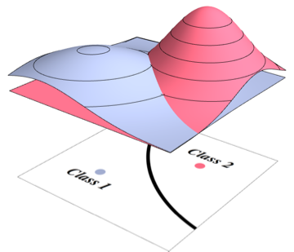
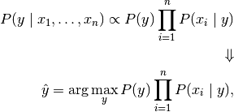
Naïve Bayes classifier
http://scikit-learn.org/stable/modules/classes.html#module-sklearn.naive_bayes

Slide 8

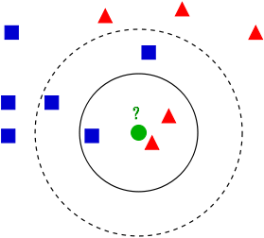
K-Nearest Neighbors
Classify an example by majority vote of its neighboring samples
Distance metric
Set value of k based on a cross-validation set
http://scikit-learn.org/stable/modules/classes.html#module-sklearn.neighbors

Slide 9
Logistic Regression
Non-parametric method for classification
Logistic regression models the probability of class i using a linear function of the input variables
Logistic function
http://www.cs.cmu.edu/~guestrin/Class/10701-S05/slides/LogRegress-1-24-05.pdf

Slide 10
Binary Logistic regression

Slide 11

How to set the values of w
Choose w that maximizes the Likelihood of the training data
L(w) = $\sum_{i=1}^{N}{P{\left(x_{i} | w\right)}^{y_{i}}×(1−P{\left(x_{i} | w\right))}^{{1−y}_{i}}}$
Log-likelihood:
… Differentiate and put equal to 0
Is there a closed form solution?
Gradient descent
Newton’s Method
http://scikit-learn.org/stable/modules/generated/sklearn.linear_model.LogisticRegression.html

Slide 12
Support Vector Machines
https://www.csie.ntu.edu.tw/~cjlin/libsvm/

Slide 13
Maximum margin classifier

Slide 14
Maximizing the Margin

Slide 15
Computing the Margin width

Slide 16
Classes may not be linearly separable

Slide 17
Kernel trick – Non-linear separation
Intractable and computationally expensive feature transform
Instead, if you applied a non-linear transform to x,
X → φ(x)
You can now write the optimization function as…
Well defined & easy to compute Kernel function
Radial basis:
Sigmoid:
https://www.csie.ntu.edu.tw/~cjlin/libsvm/

Slide 18
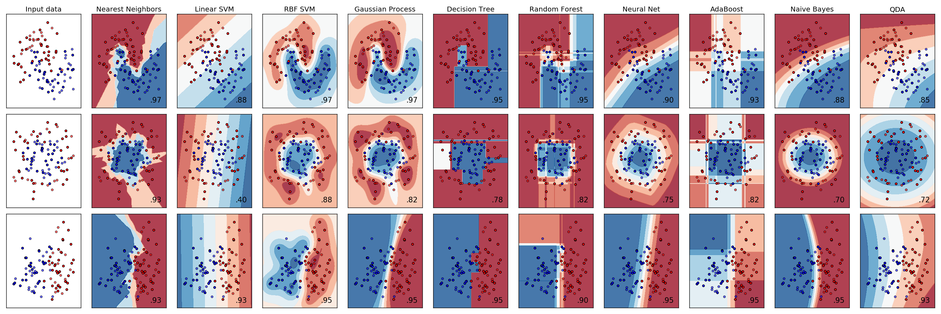
Comparison of classifiers

Slide 19
Machine Learning Concepts so far…
Identify the problem: Supervised or Unsupervised
  Classification, regression, clustering
Generative models – can generate more training examples in future using learned data distributions
Objective function – Function dependent on model parameters that we need to estimate by optimizing the function
  Log-likelihood function – Naïve Bayes, Logistic Regression
  Margin width + Correct classification – SVMs

Slide 20
Machine Learning Concepts so far…
Optimization algorithm
  Method used to optimize the objective function
  Differentiate and equate to 0
  Gradient descent, Newton’s method, Lagrange multipliers, …
Kernel functions
  A simple transform applied to the Covariance matrix that “mimics” a non-linear transform on the features in order to learn a non-linear separating hyperplane

Slide 21
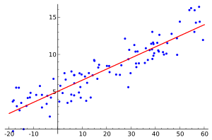
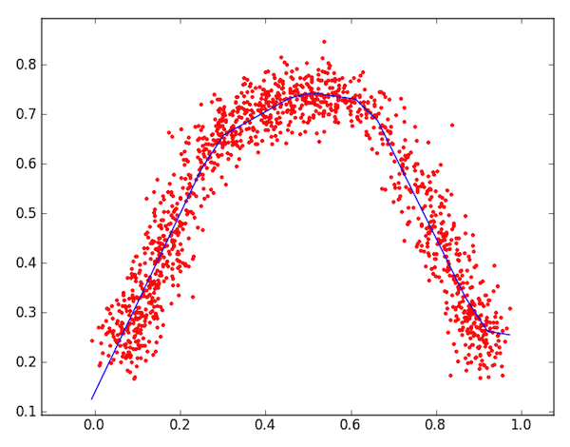
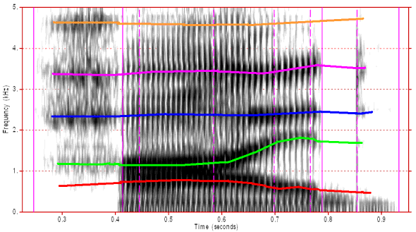
Regression problem
Given a set of input-output pairs D = {(x_{i},y_{i})}_{i=1}^{N} where y_{i} are continuous values.
Learn model y = f(X) that predicts the value of output from input features X
In speech
Pitch estimation
Formant tracking
Estimating age

Slide 22

Least Squares regression
Linear Regression model:
Least squares error:
$$y=w^{T}x$$

Slide 23
Ridge Regression
Concept of regularization
  Adding a term to the cost function for model simplicity and better generalization
  Usually works against the loss function
  Why?
  Can we add a different regularizer?
Regularizer

Slide 24
Ridge regression

Slide 25
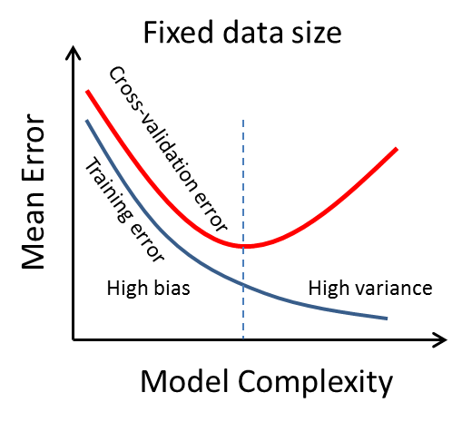
Best practices
Cross Validation set
  Set of data on which helps you decide how much to minimize your cost function on the training set
  Training, cross validation & test sets should be different.
  Usually, 80%, 10%, 10% split

Slide 26
Best practices
k-fold validation
  Split dataset into k subsets. Train on k-1 sets and evaluate on held out set
  Do cross validation on a random subset of the training split.
  Do not cross-validate on test set
Speaker independent system – Leave one speaker out test

Slide 27
Bias vs Variance of Model

Slide 28
Model with High bias

Slide 29
References
Support Vector Machine Tutorial by Prof. Andrew W. Moore: https://www.autonlab.org/tutorials/svm.html
Machine Learning advice by Dr. Andrew Ng: http://cs229.stanford.edu/materials/ML-advice.pdf
Machine Learning - A Probabilistic Perspective By Kevin P. Murphy: https://mitpress.mit.edu/books/machine-learning-0
Scikit learn: http://scikit-learn.org/stable/
Libsvm: https://www.csie.ntu.edu.tw/~cjlin/libsvm/

