Slide 1
Articulatory representations of speech
Ganesh SIvaraman

Slide 2
Outline
Motor theory of speech perception
Phonetic feature theory
Discrete articulatory representations
Speech as Articulatory movements
Synthetic model of Speech production – The Task Dynamics model
Representations of Real articulatory movements
Measurement techniques and representations
Estimating articulatory movements from speech: Speech inversion
Relevance of articulatory representations in Machine and Human speech recognition

Slide 3
Human speech production system

Slide 4
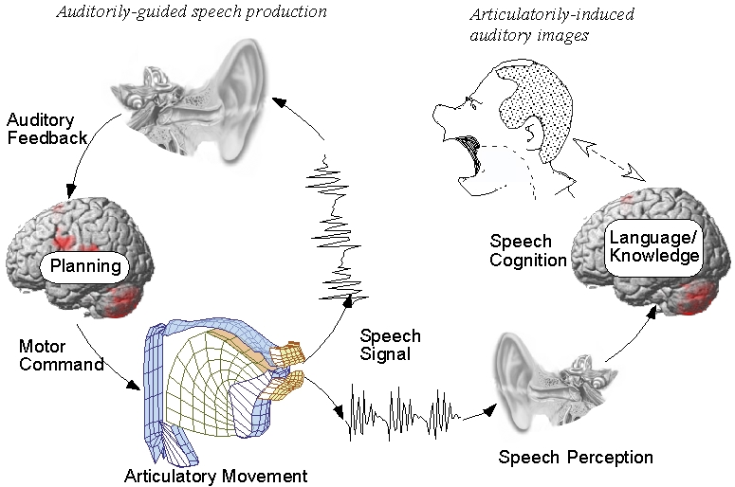
Motor theory of speech perception
The motor theory of speech perception is the hypothesis that people perceive spoken words by identifying the vocal tract gestures with which they are pronounced rather than by identifying the sound patterns that speech generates.

Slide 5
Machine vs Human Speech Recognition
Automatic vs Human speech recognition performance in “null grammar” (NullG-Eval0 dataset) (Juneja, 2012)
8000 word vocabulary
8000 word vocabulary (Figure taken from Juneja, (2012))
Notes:
What are the results with LM?

Slide 6
Reason for the gap in performance
Speech Variability
Speaker variations gender, age, dialect, nativity, idosyncratic behavior, voice quality
Manner of speech Speaking rate, speaking style, prosody, emotions,
Coarticulation & lenition
Noise
Notes:
Add noise

Slide 7
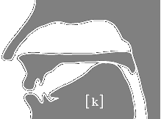
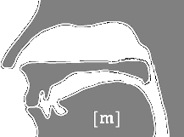
Example showing how articulatory features can be useful
Perfect memory (normal rate)
Perfect memory (fast rate)
2000
2000
0
0
-2000
0.1
0.2
0.3
0.4
0.5
0.6
0.7
-2000
0.1
0.2
0.3
8000
8000
Frequency
4000
4000
Frequency
0
0
0.1
0.2
0.3
0.1
0.2
0.3
0.4
0.5
0.6
0.7
10
10
TB
0
TB
0
-10
-10
0.1
0.2
0.3
15
0.1
0.2
0.3
0.4
0.5
0.6
0.7
15
10
TT
10
TT
5
5
0
0
0.1
0.2
0.3
0.1
0.2
0.3
0.4
0.5
0.6
0.7
25
25
LA
20
LA
20
15
15
0.1
0.2
0.3
0.4
0.5
0.6
0.7
0.1
0.2
0.3
time (secs)
time (secs)
SRI International's DECIPHER® Speech Recognition system*
Phone: p er f ih k ah m er iy Words: perfect memory
Phone: v er g eh r iy Words: part of the river
*GMM-HMM model with 4-gram phone based language model
Notes:
Put the phrase on top
Oth lenition and more coarticulation happening

Slide 8
Articulatory features
Articulatory features are representations of speech that provide a sequence of states of the articulators (organs) involved in production of the desired speech signal.
Different representations of articulatory features:
Discrete articulatory features: Discrete positions of articulators motivated by distinctive phonetic feature theory
Continuous articulatory features: Continuous values representing actual or simulated movements of articulators.

Slide 9
Phonetic feature theory
20 or so phonetic features characterizing all of the world’s languages
Based on the position of the articulators
3 categories:
Manner-of-articulation features are related to how open or closed the vocal tract is
Place-of-articulation features specify where the main constriction is located in the vocal tract
Source feature specifies opening of the glottis and vibration of the vocal folds

Slide 10
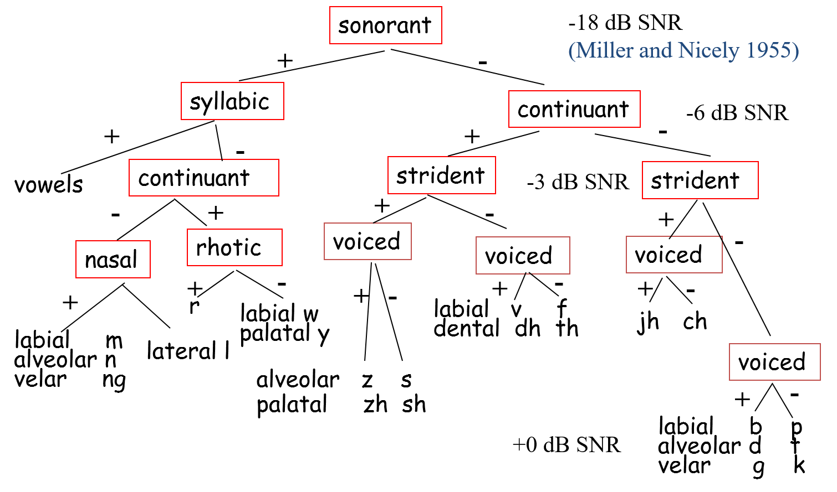
Phonetic feature hierarchy

Slide 11
Distinctive Phonetic features as discrete articulatory features

Slide 12
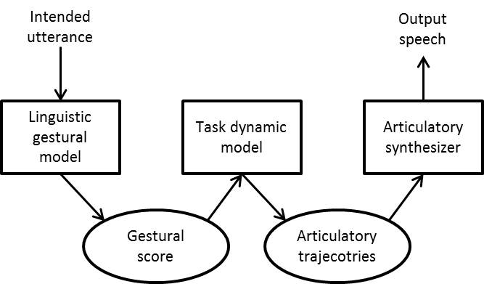
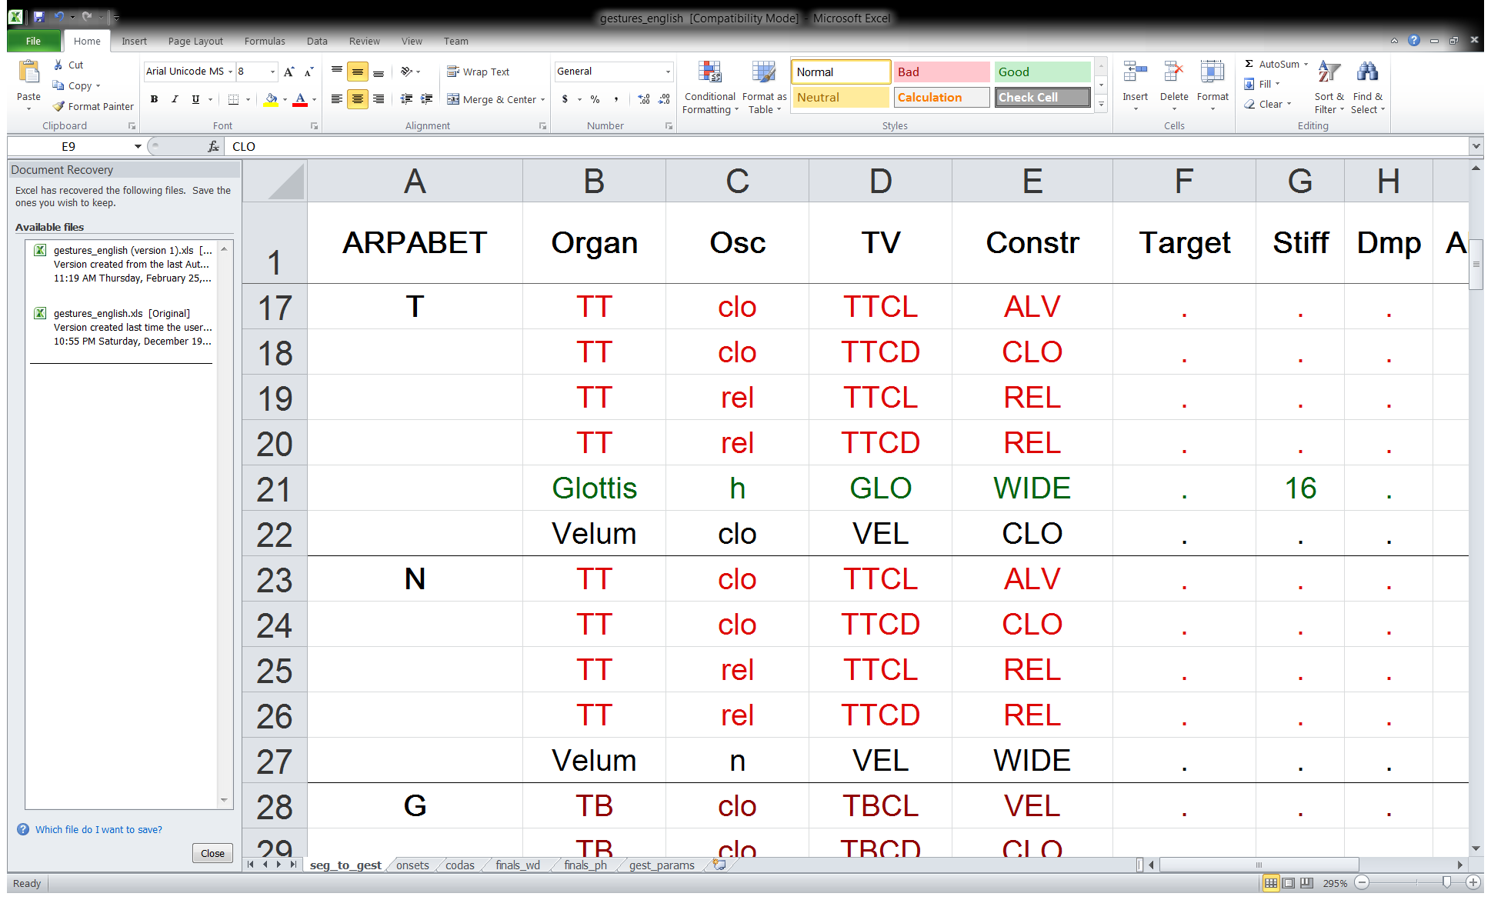
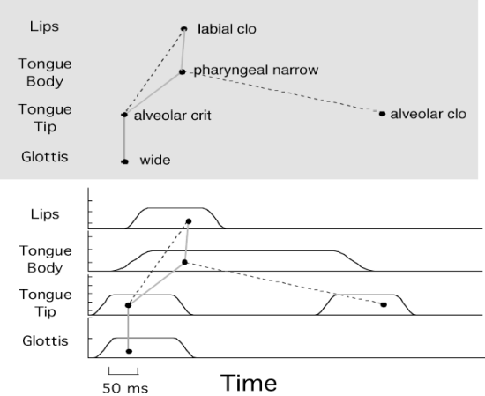
Continuous representations of speech production – Articulatory phonology
Hello World
$$M\ddot{x}+b\dot{x}+k\left(x−x_{o}\right)=0$$
clo
rel
phar wide
clo
clo
wide
Browman & Goldstein, (1992)

Slide 13
Task Dynamics: Computational model of speech production
Real world
Computational model

Slide 14
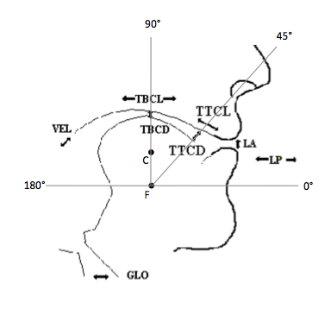
Tract variables
Vocal tract constriction variables that describe the location and degree of constriction produced by the articulators.
Constriction organ | Vocal tract variables | Articulators
Lip | Lip Aperture (LA) | Upper lip, lower lip, jaw
 | Lip Protrusion (LP)
Tongue Tip | Tongue tip constriction degree (TTCD) | Tongue body, tip, jaw
 | Tongue tip constriction location (TTCL)
Tongue Body | Tongue body constriction degree (TBCD) | Tongue body, jaw
 | Tongue body constriction location (TBCL)
Velum | Velum (VEL) | Velum
Glottis | Glottis (GLO) | Glottis
Tract variables (TVs)

Slide 15
Example of gestures and Tract variables from TADA

Slide 16
Limitations of synthetic model
Synthetic model does not provide all variabilities observed in real speech production
Articulatory speech synthesizer sounds unnatural and far from real speech

Slide 17
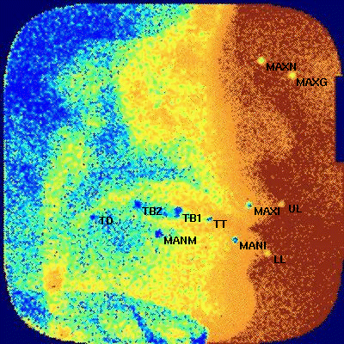
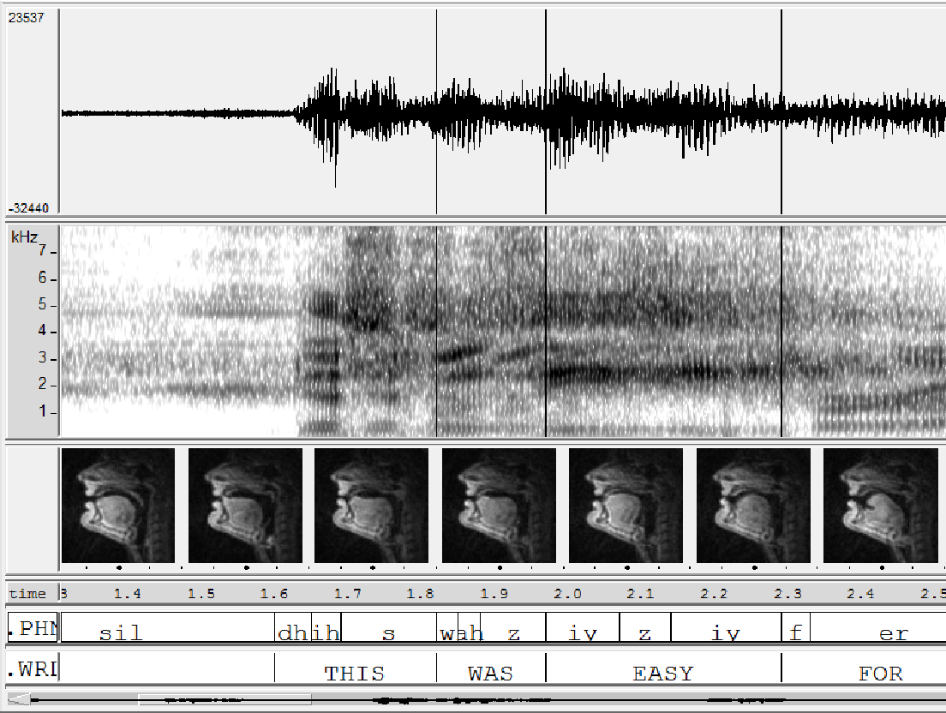
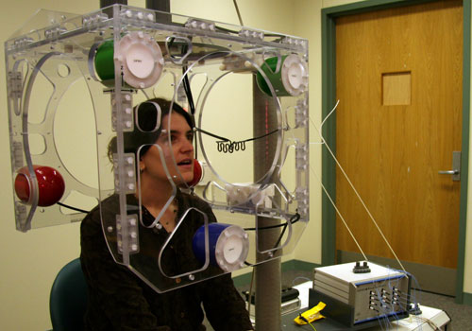
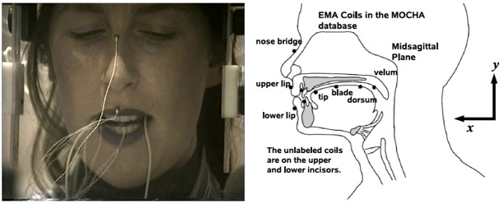
Measurement of articulatory data
X-ray microbeam
Electromagnetic Midsaggital Articulometry (EMA)
Real Time Magnetic Resonance Imaging (rt-MRI)

Slide 18
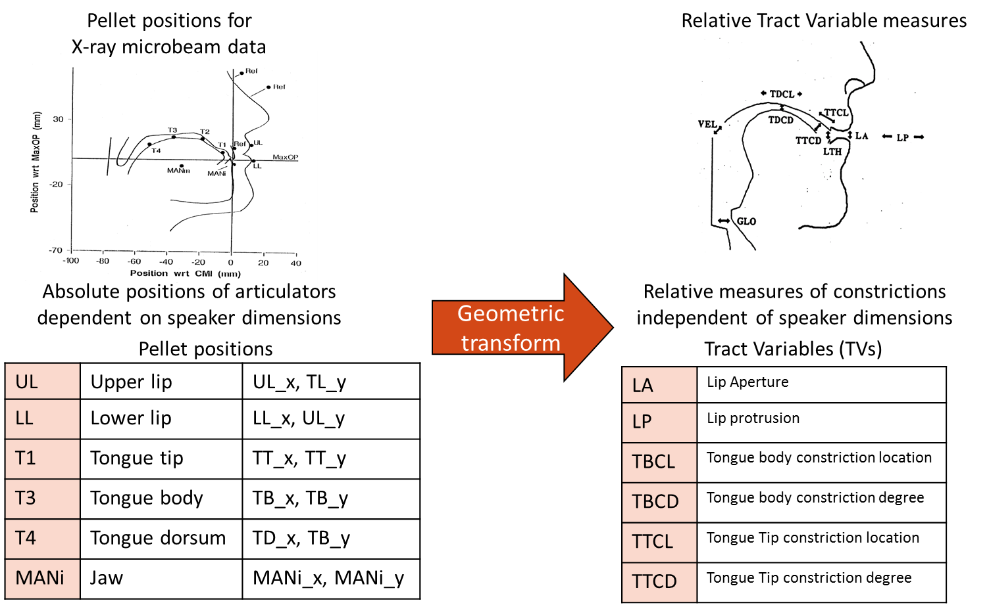
Converting real articulatory data to TVs
Why?
TVs are a more speaker independent representation than pellet positions.
Because they are relative measures of constriction position and degree
Use the TADA theoretical framework to analyze the phonological phenomena.
Less non-uniqueness in acoustic to articulatory mapping
Notes:
SHOULD YOU SAY “CONVERTING POINT-SOURCE DATA TO TRACT VARIABLES”? DON’T FORGET TO MENTION HERE THAT PREVIOUS WORK WAS BASED ON TADA GENERATED TRACT VARIABLES, GESTURE AND SYNTHETIC DATA

Slide 19
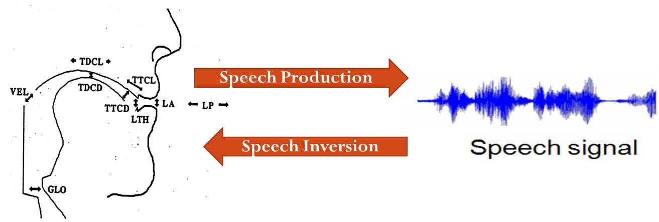
Acoustic to Articulatory Speech Inversion
Challenges
Highly nonlinear and somewhat non-unique mapping from acoustics to articulations
Different possible representations of articulatory data
Approaches
Codebook based approaches (Schroeter and Sondhi, (1994))
Gaussian Mixture Models (GMM) and Hidden Markov Models (HMMs) (Toda et al., (2004))
Artificial Neural Networks (ANN) (Mitra, (2010))
Notes:
Get rid of this. Include the info in 11

Slide 20
Speech Inversion System
Input Speech
MFCC Feature extraction
Contextual window of 160ms
Kalman Smoothing
Tract Variables
Function mapping approach to speech inversion
Artificial neural networks (ANN) suitable for the highly non-linear and non-unique mapping from acoustics to TVs (V.Mitra et al. (2010))
Input features: Contextualized MFCCs (13 coeffs x 17 frames)
Outputs: 6 TVs (LA, LP, TBCL, TBCD, TTCL, TTCD)
Three Hidden layer networks – Trained on an Nvidia Titan X GPU
100 – 500 nodes in hidden layer
Stochastic Gradient Descent (SGD) algorithm for training.

Slide 21
Results of Speaker Independent Speech Inversion
X-ray Microbeam (XRMB) dataset converted to TVs
46 different speaker (21 males, 25 females)
Around 4 hours of training data
Trained on 36 speakers. Cross validation and testing on 5 speakers’ data for each
Mean, Variance Normalization: Speaker specific normalization (SPKNORM)
Pearson Product Moment Correlation (PPMC) between estimated and actual TVs
TV | PPMC
LA | 0.78
LP | 0.64
TBCL | 0.86
TBCD | 0.71
TTCL | 0.73
TTCD | 0.84
Mean | 0.76

Slide 22
Example estimates
Try it for free @ https://github.com/ganesa90/speech-inversion-matlabNN

Slide 23
Speech invertion on synthetic data
 | GLO | VEL | LA | LP | TTCD | TTCL | TBCD | TBCL
Speaker dependent | 0.98 | 0.96 | 0.93 | 0.96 | 0.95 | 0.94 | 0.95 | 0.97
Speaker independent | 0.97 | 0.95 | 0.91 | 0.97 | 0.95 | 0.94 | 0.94 | 0.96
Used the CMU dictionary and selected 111,929 words
Fed Arpabet pronunciations of those words into TADA and generateftheir corresponding TVs (refer to Table 1) and synthetic speech. Each word from the CMU dictionary was separately fed to TADA four or five times. For each iteration, TADA randomly selected (a) between a male and a female speaker, whose mean pitch was randomly picked from a uniform distribution; (b) a different speaking rate (fast, normal, or slow); and (c) a different set of articulatory weights to introduce speaker-specific traits. This process enabled simulating a diverse set of speakers. Altogether 534,322 audio samples were generated (approximately 450 hours of speech), out of which 88% of the data was used as the training set, 2% was used as the cross-validation set, and the remaining 10% was used as the test set. We name this as the Synthetic Multi-Speaker clean (SMS-clean) dataset.

Slide 24
Speaker dependent inversion systems
10 speakers (5 males, 5 females) chosen randomly from the XRMB dataset such that each speaker had roughly same amount of data
ANN Speech inversion systems trained for each speaker.
Performance evaluated using PPMC measure on test set (same speaker) (10% of available data)
 | Spk ID | Gender | Minutes of data | LA | LP | TBCL | TBCD | TTCL | TTCD | Average
Speaker 1 | JW12 | M | 7.01 | 0.78 | 0.75 | 0.89 | 0.79 | 0.73 | 0.87 | 0.80
Speaker 2 | JW14 | F | 6.26 | 0.76 | 0.60 | 0.90 | 0.75 | 0.80 | 0.85 | 0.78
Speaker 3 | JW24 | M | 7.58 | 0.80 | 0.70 | 0.88 | 0.69 | 0.72 | 0.74 | 0.75
Speaker 4 | JW26 | F | 8.54 | 0.75 | 0.78 | 0.89 | 0.74 | 0.77 | 0.87 | 0.80
Speaker 5 | JW27 | F | 6.83 | 0.74 | 0.69 | 0.85 | 0.69 | 0.66 | 0.82 | 0.74
Speaker 6 | JW31 | F | 7.99 | 0.82 | 0.73 | 0.91 | 0.83 | 0.72 | 0.89 | 0.82
Speaker 7 | JW40 | M | 6.32 | 0.76 | 0.53 | 0.91 | 0.72 | 0.82 | 0.86 | 0.77
Speaker 8 | JW45 | M | 7.35 | 0.79 | 0.69 | 0.87 | 0.75 | 0.77 | 0.81 | 0.78
Speaker 9 | JW54 | F | 6.76 | 0.69 | 0.51 | 0.87 | 0.71 | 0.84 | 0.80 | 0.74
Speaker 10 | JW59 | M | 6.57 | 0.75 | 0.72 | 0.90 | 0.78 | 0.78 | 0.85 | 0.80

Slide 25
Cross Speaker performance
Each speaker dependent system was evaluated on the test sets of the remaining 9 speakers.
 | Spkr1 (M) | Spkr 2 (F) | Spkr 3 (M) | Spkr 4 (F) | Spkr 5 (F) | Spkr 6 (F) | Spkr 7 (M) | Spkr 8 (M) | Spkr 9 (F) | Spkr10 (M)
Spkr 1 (M) | 0.80 | 0.52 | 0.62 | 0.47 | 0.36 | 0.30 | 0.52 | 0.58 | 0.52 | 0.56
Spkr 2 (F) | 0.53 | 0.78 | 0.50 | 0.61 | 0.56 | 0.49 | 0.33 | 0.41 | 0.60 | 0.47
Spkr 3 (M) | 0.62 | 0.51 | 0.75 | 0.44 | 0.29 | 0.24 | 0.53 | 0.58 | 0.50 | 0.61
Spkr 4 (F) | 0.55 | 0.59 | 0.47 | 0.80 | 0.56 | 0.56 | 0.31 | 0.39 | 0.57 | 0.41
Spkr 5 (F) | 0.44 | 0.55 | 0.29 | 0.59 | 0.74 | 0.64 | 0.13 | 0.17 | 0.50 | 0.34
Spkr 6 (F) | 0.30 | 0.44 | 0.17 | 0.51 | 0.54 | 0.82 | 0.17 | 0.15 | 0.35 | 0.18
Spkr 7 (M) | 0.53 | 0.38 | 0.50 | 0.34 | 0.21 | 0.20 | 0.77 | 0.56 | 0.41 | 0.49
Spkr 8 (M) | 0.58 | 0.49 | 0.60 | 0.38 | 0.23 | 0.13 | 0.59 | 0.78 | 0.52 | 0.60
Spkr 9 (F) | 0.55 | 0.59 | 0.49 | 0.61 | 0.51 | 0.42 | 0.42 | 0.46 | 0.74 | 0.49
Spkr 10 (M) | 0.56 | 0.46 | 0.54 | 0.40 | 0.29 | 0.22 | 0.47 | 0.54 | 0.45 | 0.80

Slide 26
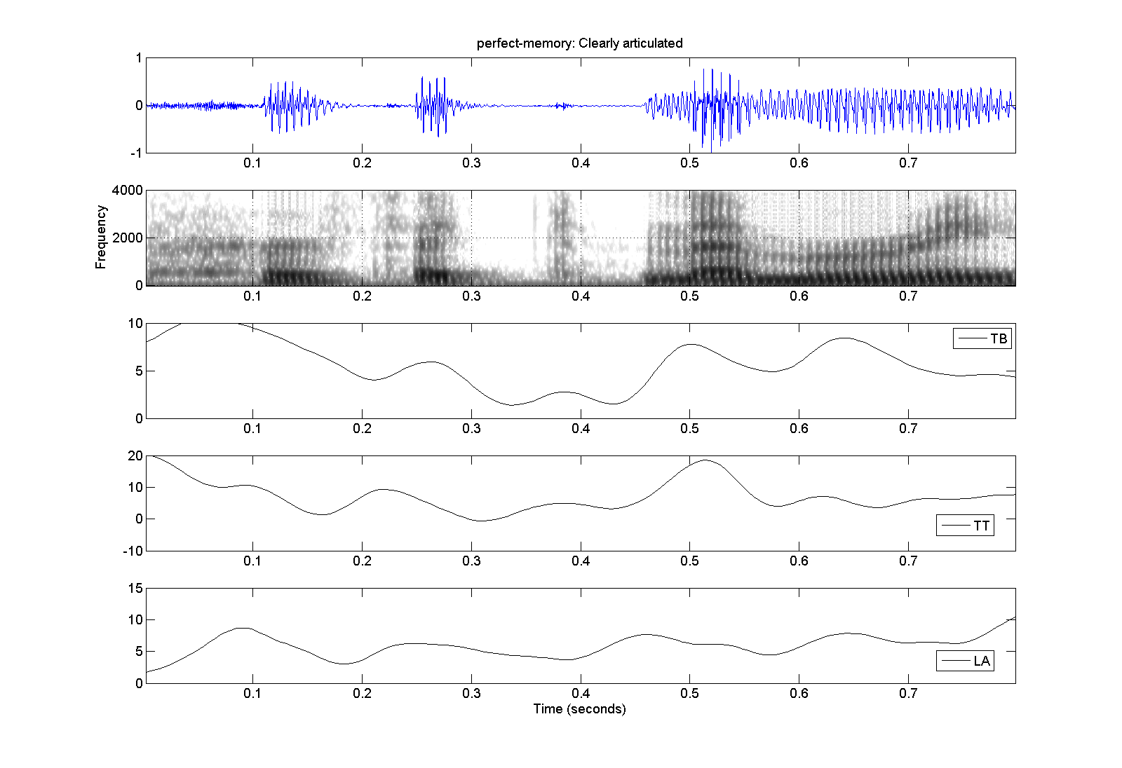
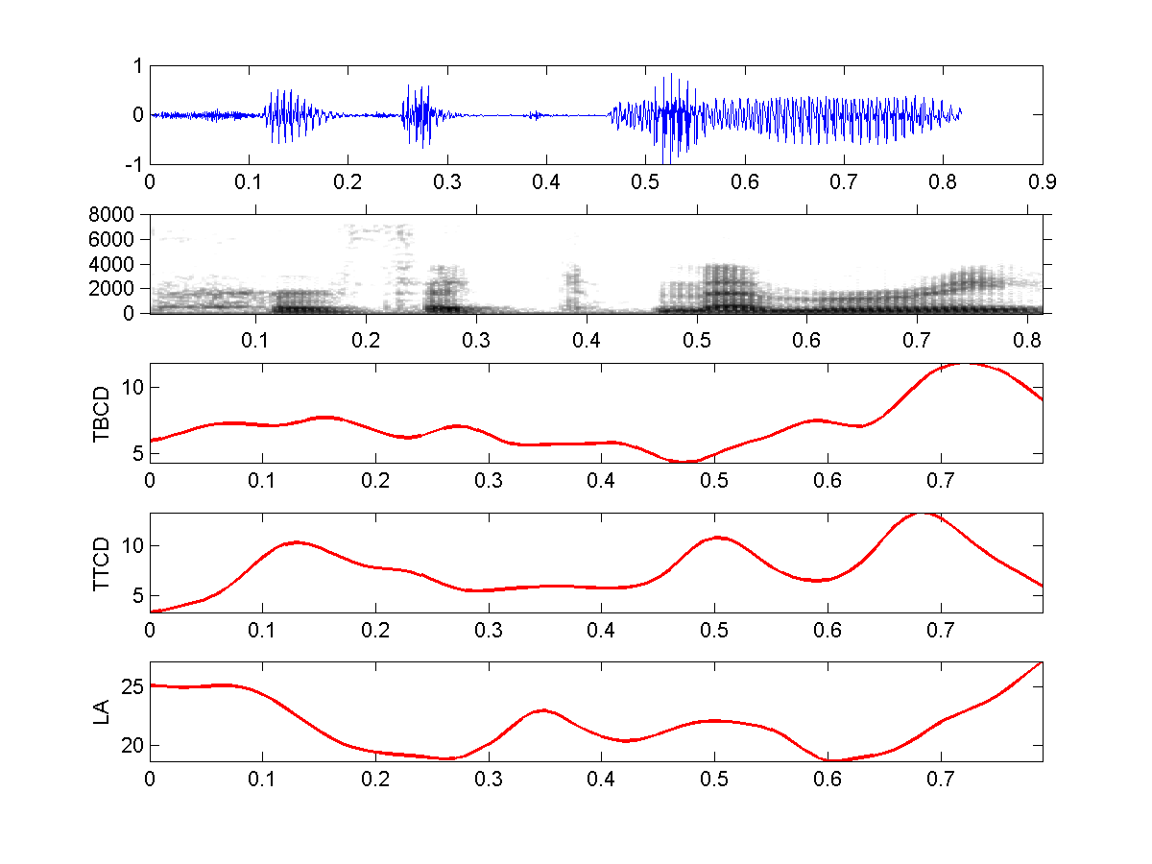
Perfect memory clearly spoken
perfect-memory: Clearly articulated
2000
0
-2000
0.1
0.2
0.3
0.4
0.5
0.6
0.7
8000
Frequency
4000
0
0.1
0.2
0.3
0.4
0.5
0.6
0.7
10
TB
0
-10
0.1
0.2
0.3
0.4
0.5
0.6
0.7
15
TT
10
5
0
0.1
0.2
0.3
0.4
0.5
0.6
0.7
25
LA
20
15
0.1
0.2
0.3
0.4
0.5
0.6
0.7
time (secs)

Slide 27
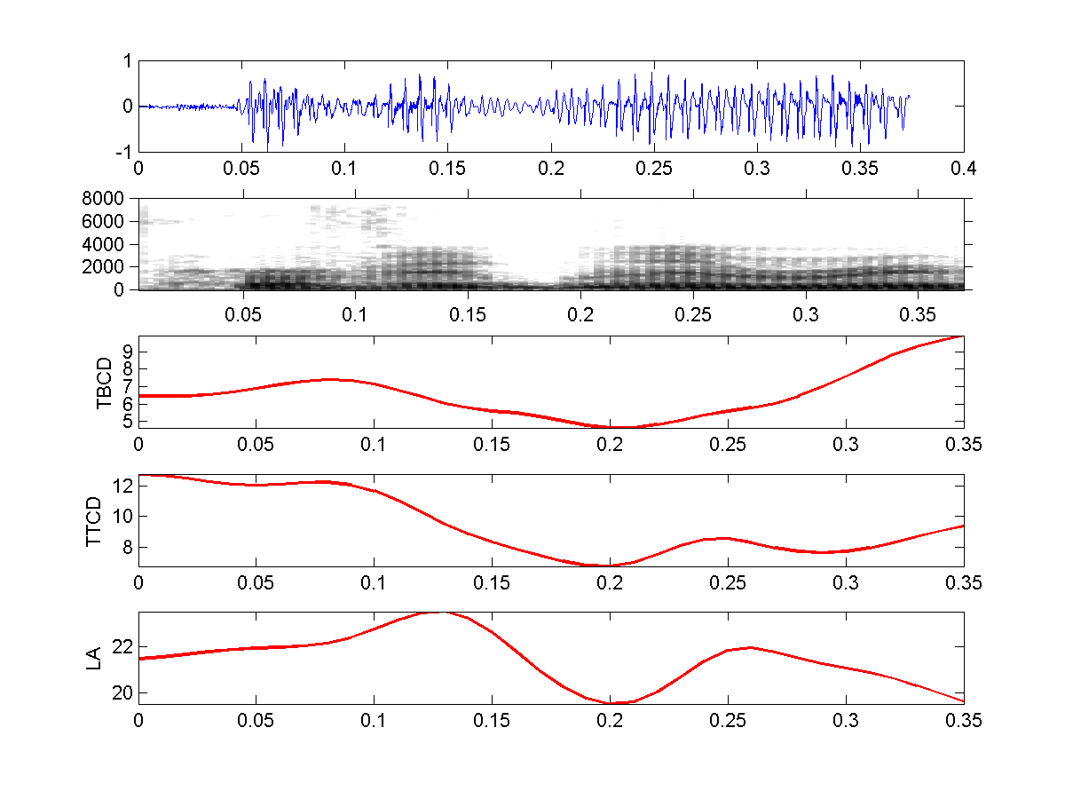
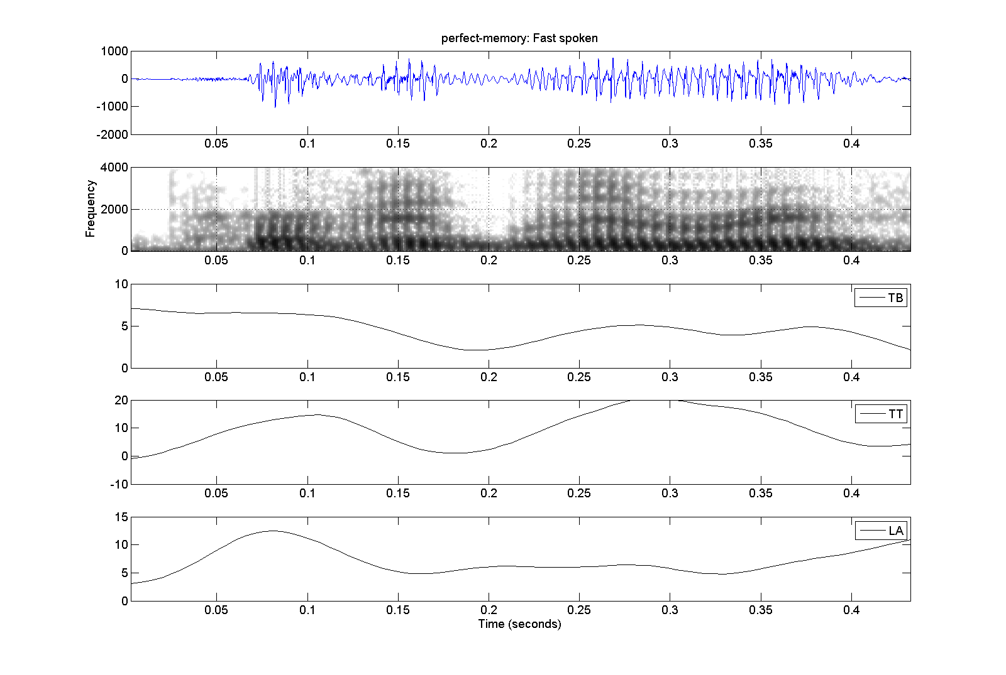
Perfect memory fast spoken
TV estimates from natural data
TV estimates from synthetic data
perfect-memory: Fast spoken
2000
0
-2000
0.1
0.2
0.3
8000
Frequency
4000
0
0.1
0.2
0.3
10
TB
0
-10
0.1
0.2
0.3
15
TT
10
5
0
0.1
0.2
0.3
25
LA
20
15
0.1
0.2
0.3
time (secs)

Slide 28
Bunched vs Retroflexed /r/
Bunched
Retroflexed

Slide 29
Distinguishing bunched vs retroflexed /r/ using speech inversion

Slide 30
Have articulatory features helped in ASR?
Experiments performed using synthetic Tract Variables (TVs) in Large vocabulary speech recognition
Experiments performed on noisy speech dataset from Aurora 4
Shows robustness to noise distortion
 | Model | A | B | C | D | avg.
GFB | TFCNN | 3.1 | 5.7 | 6.1 | 14.6 | 9.4
GFB+TV-DNN_{CLEAN} | HCNN | 3.3 | 5.7 | 5.5 | 14.2 | 9.2
GFB+TV-CNN_{CLEAN} | HCNN | 3.0 | 5.7 | 5.5 | 14.2 | 9.1
GFB+TV-DNN_{NOISY} | HCNN | 2.8 | 5.6 | 5.4 | 14.3 | 9.0
GFB+TV-CNN_{NOISY} | HCNN | 2.6 | 5.6 | 5.5 | 14.0 | 8.9
GFB+TV-DNN_{NOISY} | fCNN | 2.8 | 5.5 | 5.8 | 13.8 | 8.9
GFB+TV-CNN_{NOISY} | fCNN | 2.8 | 5.5 | 5.4 | 14.1 | 9.0

Slide 31
Real articulatory features for ASR
Work in progress to perform full range of ASR experiments with real articulatory features
Preliminary results show small improvements in clean speech conditions
Further parametrization og articulatory features need to be experimented
Features | Acoustic model | %Correct | %Substitutions | %Deletions | %Insertions | %Error | %Sent Error
GFB | DNN_5x1024 | 95.4 | 3.8 | 0.8 | 1.4 | 6 | 46.9
GFB_XTV | DNN_5x1024 | 95.4 | 3.8 | 0.8 | 1.4 | 6 | 44.6
GFB_XTV | HCNN | 95.6 | 3.5 | 0.9 | 1.2 | 5.6 | 44.8

Slide 32
Relevance of articulatory features in Deep neural networks for ASR
Nagmine et.al. Interspeech 2015

Slide 33
Clustering of 5th layer of DNNs
Nagmine et.al. Interspeech 2015

Slide 34
Evidence from neuroscience
https://www.ncbi.nlm.nih.gov/pmc/articles/PMC4350233/pdf/nihms663726.pdf

Slide 35
Clustering of electrodes
Mesgarani et.al. Science 2014

Slide 36
Clustering according to phonetic features
Mesgarani et.al. Science 2014

Slide 37
References
Juneja, A., 2012. A comparison of automatic and human speech recognition in null grammar. J. Acoust. Soc. Am. 131, EL256–61. doi:10.1121/1.3684744
Sivaraman, G., Mitra, V., Tiede, M.K., Saltzman, E., Goldstein, L., Espy-Wilson, C.Y., 2015b. Analysis of coarticulated speech using estimated articulatory trajectories, in: INTERSPEECH. Drezden, pp. 369–373.
Browman, C.P., Goldstein, L., 1992. Articulatory Phonology : An Overview *. Phonetica 49, 155–180.
Nam, H., Goldstein, L., Saltzman, E., Byrd, D., 2004. TADA: An enhanced, portable Task Dynamics model in MATLAB. J. Acoust. Soc. Am. 115, 2430. doi:10.1121/1.4781490

Slide 38
References
Westbury, J.R., 1994. Microbeam Speech Production Database User’'s Handbook. IEEE Pers. Commun. - IEEE Pers. Commun.
Mitra, V., Nam, H., Espy-Wilson, C.Y., Saltzman, E., Goldstein, L., 2010. Retrieving Tract Variables From Acoustics: A Comparison of Different Machine Learning Strategies. IEEE J. Sel. Top. Signal Process. 4, 1027–1045. doi:10.1109/JSTSP.2010.2076013
G. Sivaraman, V.Mitra, H. Nam, M.K. Tiede, C. Espy-Wilson (2016) Vocal tract length normalization for speaker independent acoustic-to-articulatory speech inversion, Proc. of INTERSPEECH 2016
G. Sivaraman, C. Espy-Wilson, V. Mitra, H. Nam, E. Saltzman (2014). Analysis of acoustic to articulatory speech inversion for natural speech. The Journal of the Acoustical Society of America, 136(4), 20822082
Nagamine, T., Seltzer, M.L., Mesgarani, N., 2015. Exploring How Deep Neural Networks Form Phonemic Categories, in: Interspeech 2015.
N. Mesgarani, C. Cheung, K. Johnson, and E. F. Chang, “Phonetic Feature Encoding in Human Superior Temporal Gyrus,” Science, vol. 343, no. 6174, pp 1006-1010, 2014.

