Slide 1
Deep neural networks for automatic speech recognition
Ganesh Sivaraman

Slide 2
Overview
HMM initialization
Decoding words from HMM states
Language models
Limitations of HMMs for speech recognition
Feedforward neural networks recap. How they became deep?
Two approaches to involving DNNs in ASR
Tandem approach
Replacing GMMs for posterior estimation
Recurrent neural networks
A view of where ASR stands today

Slide 3
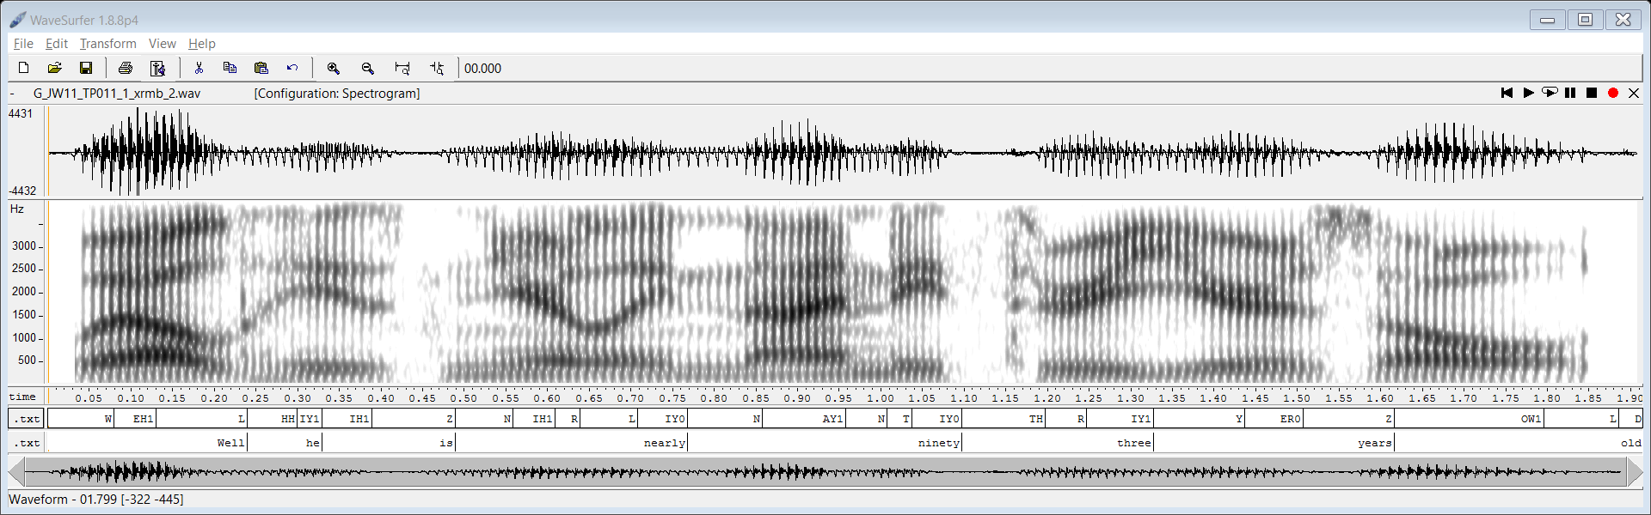
HMM initialization
MFCC
13 dimensions + deltas
Step1: Always start with monophone models
40 monophones = 40 HMMs (200 states)
Initialization of HMM – Uniform segmentation and flat start

Slide 4
HMM initializtion
MFCC
13 dimensions + deltas
W EH1 L HH IY1 IH1 Z N IH1 R L IY0 N AY1 N T IY0 TH R IY1 Y ER0 Z OW1 L D
Uniform segmentations and flat start
W
EH1
Perform multiple repetitions of GMM training and Viterbi algorithm
E-M iterations

Slide 5
Monophone and triphone HMM models
MFCC
13 dimensions + deltas
W EH1 L HH IY1 IH1 Z N IH1 R L IY0 N AY1 N T IY0 TH R IY1 Y ER0 Z OW1 L D
After multiple iterations of E-M algorithm
W
EH1
Alignments become more correct
This is a well trained monophone HMM model
Sil-W-eh1
W-EH1-L
Initialize your triphone HMM model with the trained monophone HMM parameters. Each monophone state is converted to triphone state with parameters same as monophone HMM states.
Run E-M iterations of HMM training on the triphone states now

Slide 6
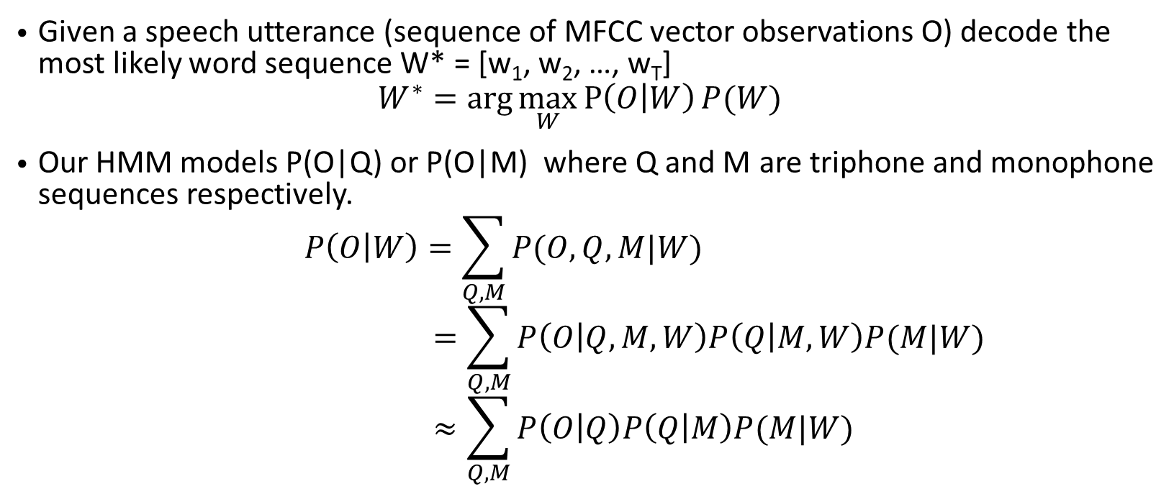
Decoding words from HMM states
Given a speech utterance (sequence of MFCC vector observations O) decode the most likely word sequence W* = [w₁, w₂, …, w_{T}]
$$W^{∗}=\arg{\max_{W}{P\left(O | W\right)P(W)}}$$
Our HMM models P(O|Q) or P(O|M) where Q and M are triphone and monophone sequences respectively.
$$P\left(O | W\right)=\sum_{Q,M}{P(O,Q,M|W)} \\ =\sum_{Q,M}{P\left(O | Q,M,W\right)P\left(Q | M,W\right)P(M|W)} \\ ≈\sum_{Q,M}{P\left(O | Q\right)P\left(Q | M\right)P(M|W)}$$
Language model
Viterbi decoding of HMM states
Triphone 2 phoneme transducer
Pronunciation dictionary

Slide 7
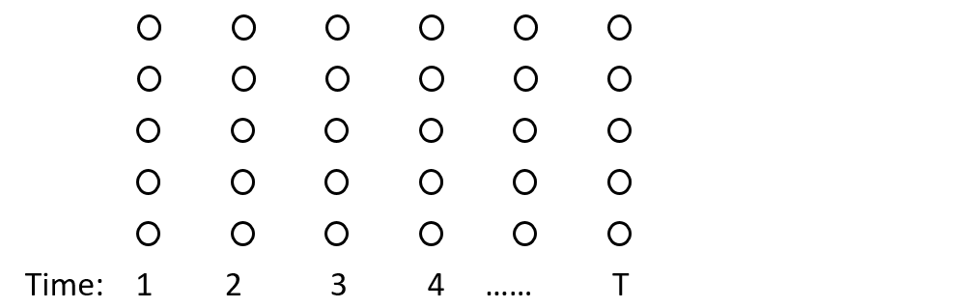
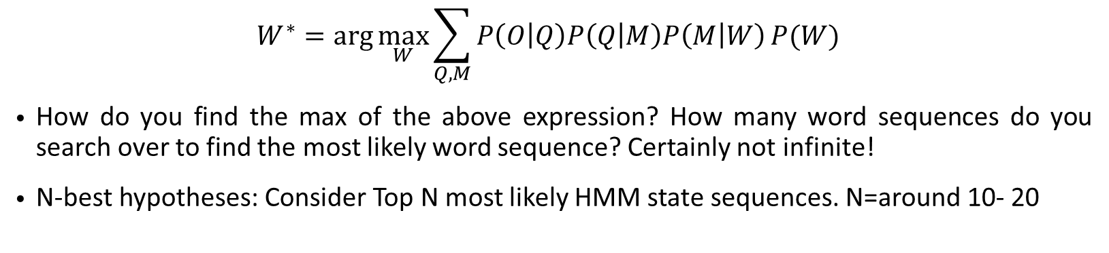
N-best hypotheses
$$W^{∗}=\arg{\max_{W}{\sum_{Q,M}{P\left(O | Q\right)P\left(Q | M\right)P\left(M | W\right)}P(W)}}$$
How do you find the max of the above expression? How many word sequences do you search over to find the most likely word sequence? Certainly not infinite!
N-best hypotheses: Consider Top N most likely HMM state sequences. N=around 10- 20
= HMM state

Slide 8
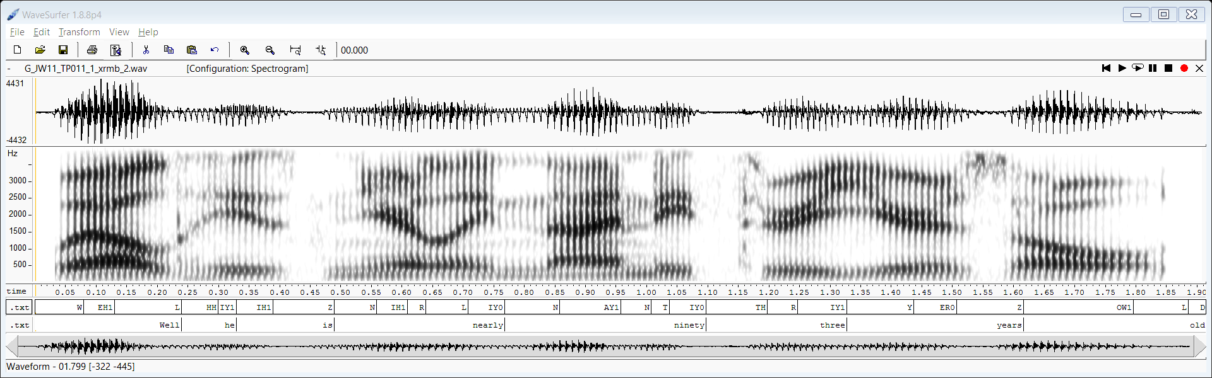
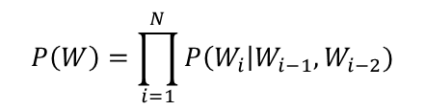


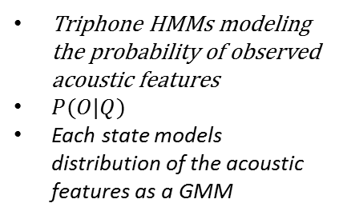
Automatic Speech Recognition (ASR) pipeline
Feature extraction
Trained Acoustic model
Context transducer
Pronunciation model
Language model
Word sequence
MFCC, PLP, DOCC etc.
Triphones
Monophones
Words
$$P\left(W\right)=\prod_{i=1}^{N}{P\left(W_{i}\right|W_{i−1}, W_{i−2})}$$
Acoustic features
$$P(Q|M)$$
$$P(M|W_{1})$$
Triphone HMMs modeling the probability of observed acoustic features
$P(O|Q)$
Each state models distribution of the acoustic features as a GMM
Block diagram Courtesy: https://www.cse.iitb.ac.in/~pjyothi/cs753/index.html

Slide 9
Drawbacks of HMMs for ASR
Triphones can capture only short time contextual effects on phonemes in continuous speech
Gaussian Mixtures are a crude approximation for the state observation densities.
Conditional independence assumption of HMMs is not an accurate model because the features of adjacent frames have a significant amount of similarity and overlap
First order Markovian-ness of HMMs limits the time dependencies it can capture

Slide 10
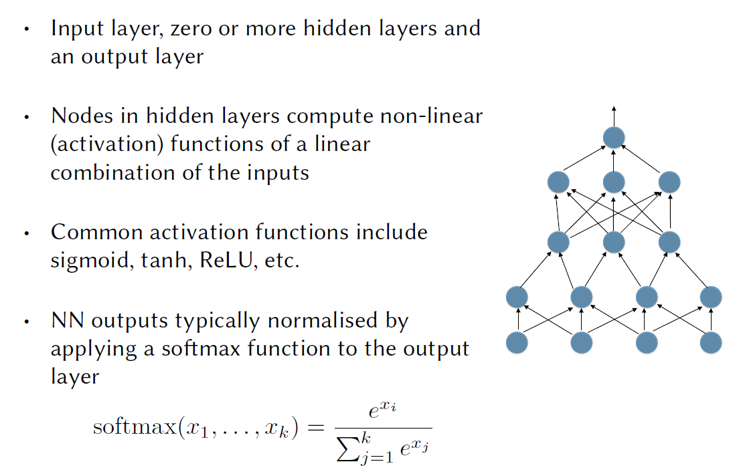
Recap: Feedforward Neural Networks
Slide Courtesy: https://www.cse.iitb.ac.in/~pjyothi/cs753/slides/lecture10.pdf

Slide 11
Recap: Training Neural Networks
Slide Courtesy: https://www.cse.iitb.ac.in/~pjyothi/cs753/slides/lecture10.pdf

Slide 12
Deep Neural Networks (DNN) in ASR
There are two main approaches to using DNNs in ASR:
  Tandem system: Using DNNs to generate better input features for a HMM-GMM acoustic model – Bottleneck neural networks
  DNN-HMM hybrid system: Using DNNs to model the observation (acoustic feature) probability distribution instead of GMMs – Landmark development in ASR leading to all the successful speech recognition systems you see today.
Slide Courtesy: https://www.cse.iitb.ac.in/~pjyothi/cs753/slides/lecture10.pdf

Slide 13
Tandem System
Monophone or triphone labels/posteriors
Train a DNN which takes acoustic features as input and estimates the label of the phoneme or triphone.
  Remember: You can get the labels from the alignments obtained by running a Monophone or triphone HMM
Output layer must be Softmax
Restrict one of the hidden layers to small dimension – Bottleneck layer
Use the outputs of the bottleneck layer as inputs to a GMM-HMM model.
Acoustic features
~10 frames of MFCCs
Slide Courtesy: https://www.cse.iitb.ac.in/~pjyothi/cs753/slides/lecture10.pdf

Slide 14
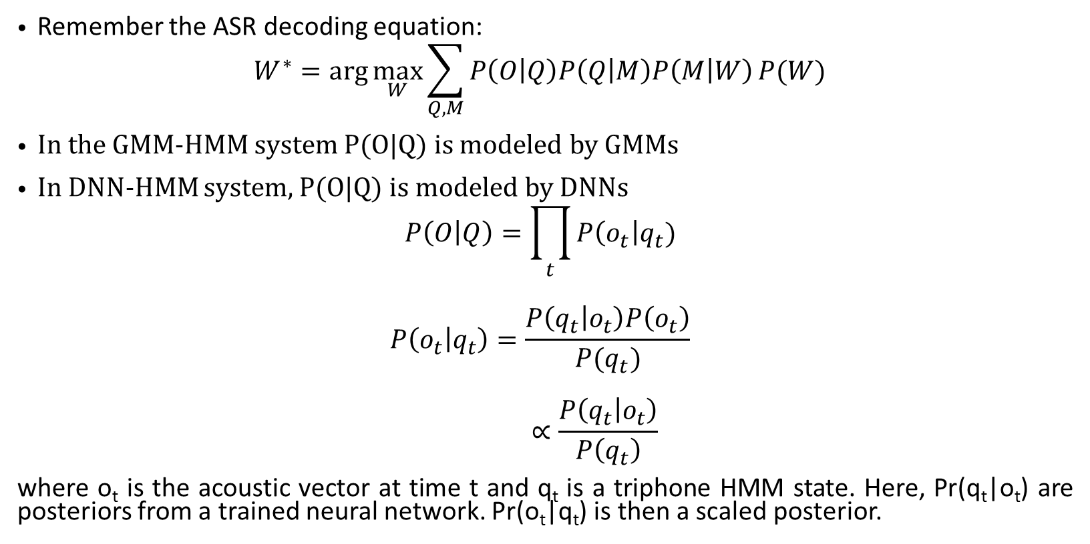
Hybrid DNN-HMM systems
Remember the ASR decoding equation:
$$W^{∗}=\arg{\max_{W}{\sum_{Q,M}{P\left(O | Q\right)P\left(Q | M\right)P\left(M | W\right)}P(W)}}$$
In the GMM-HMM system P(O|Q) is modeled by GMMs
In DNN-HMM system, P(O|Q) is modeled by DNNs
$$P\left(O | Q\right)=\prod_{t}{P\left(o_{t}\right|q_{t})}$$
$$P\left(o_{t} | q_{t}\right)=\frac{P\left(q_{t} | o_{t}\right)P\left(o_{t}\right)}{P(q_{t})}$$
$$∝\frac{P\left(q_{t} | o_{t}\right)}{P\left(q_{t}\right)}$$
where o_{t} is the acoustic vector at time t and q_{t} is a triphone HMM state. Here, Pr(q_{t}|o_{t}) are posteriors from a trained neural network. Pr(o_{t}|q_{t}) is then a scaled posterior.
Slide Courtesy: https://www.cse.iitb.ac.in/~pjyothi/cs753/slides/lecture10.pdf

Slide 15
Computing the posteriors using a DNN
Again! GMM-HMMs to the rescue! ☺
Train a triphone HMM system and align all the training data to triphone states
Slide Courtesy: https://www.cse.iitb.ac.in/~pjyothi/cs753/slides/lecture10.pdf

Slide 16
Getting acoustic feature-triphone label pairs
Feature extraction
Trained Acoustic model
Triphone States
Acoustic features
Triphones
MFCC, PLP, DOCC etc.
1 2 3 4 …… T
Running Viterbi decoding with a trained triphone HMM system will give you alignments between acoustic features and triphone states.

Slide 17
Recurrent Neural networks (RNN)
y_{t}
Y_{t}
Y_{t+1}
Y_{t+2}
Y_{t+3}
W_{ho}
W_{ho}
W_{ho}
W_{ho}
W_{ho}
H, O
W_{hh}
H, O
H, O
H, O
H, O
W_{hh}
W_{hh}
W_{hh}
Unrolling in time
W_{ih}
W_{ih}
W_{ih}
W_{ih}
W_{ih}
x_{t}
x_{t}
X_{t+1}
X_{t+2}
X_{t+3}
A. Graves, N. Jaitly, “Towards end-to-end speech recognition with recurrent neural networks”, ICML, 2014.

Slide 18
RNNs
RNNs are well suited for sequential time series data
HMMs also do time series modeling. So what’s the difference?
  The time context pattern captured by HMMs is short time because of the 1st order Markovian assumption.
  If we expand the HMM to be of higher order, then Inference (solving for the parameters) becomes intractable!
RNNs are designed to capture long time dependencies. Unlike HMMs you don’t need to have closed form expressions/algorithms for inference
Gradient descent method iteratively work to adjust RNN weights to achieve the goal of the network

Slide 19
Training an RNN
An unrolled RNN is just a very deep feedforward network
For a given input sequence:
  create the unrolled network
  add a loss function node to the network
  then, use backpropagation to compute the gradients
  This algorithm is known as backpropagation through time (BPTT)
Slide Courtesy: https://www.cse.iitb.ac.in/~pjyothi/cs753/slides/lecture10.pdf

Slide 20
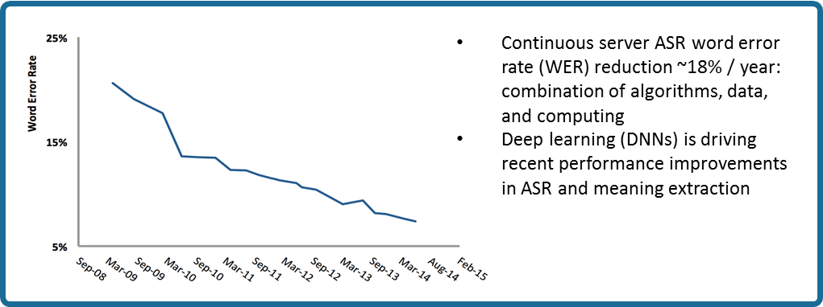
The Deep learning revolution in ASR
Wall Street Journal WER

Slide 21
Comparing GMM-HMM with DNN-HMM

Slide 22
References
https://www.cse.iitb.ac.in/~pjyothi/cs753/index.html
“Deep Neural Networks for Acoustic Modeling in Speech Recognition”, IEEE Signal Processing Magazine, 2012.
A. Mohamed, G. Dahl, and G. Hinton, “Deep belief networks for phone recognition,” NIPS Workshop on Deep Learning for Speech Recognition, 2009.
G. Dahl, D. Yu, L. Deng, and A. Acero, “Context-Dependent Pre-Trained Deep Neural Networks for Large-Vocabulary Speech Recognition,” TASL 20(1), pp. 30–42, 2012.
Vesely et al., “The language-independent bottleneck features”, SLT, 2012.
A. Graves, N. Jaitly, “Towards end-to-end speech recognition with recurrent neural networks”, ICML, 2014.

